Slide 1
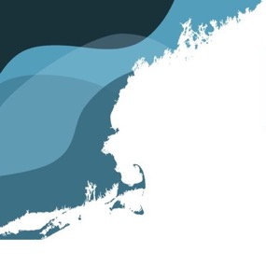
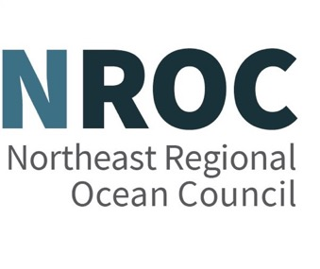
NROC Spring Meeting
May 15, 2025

Slide 2
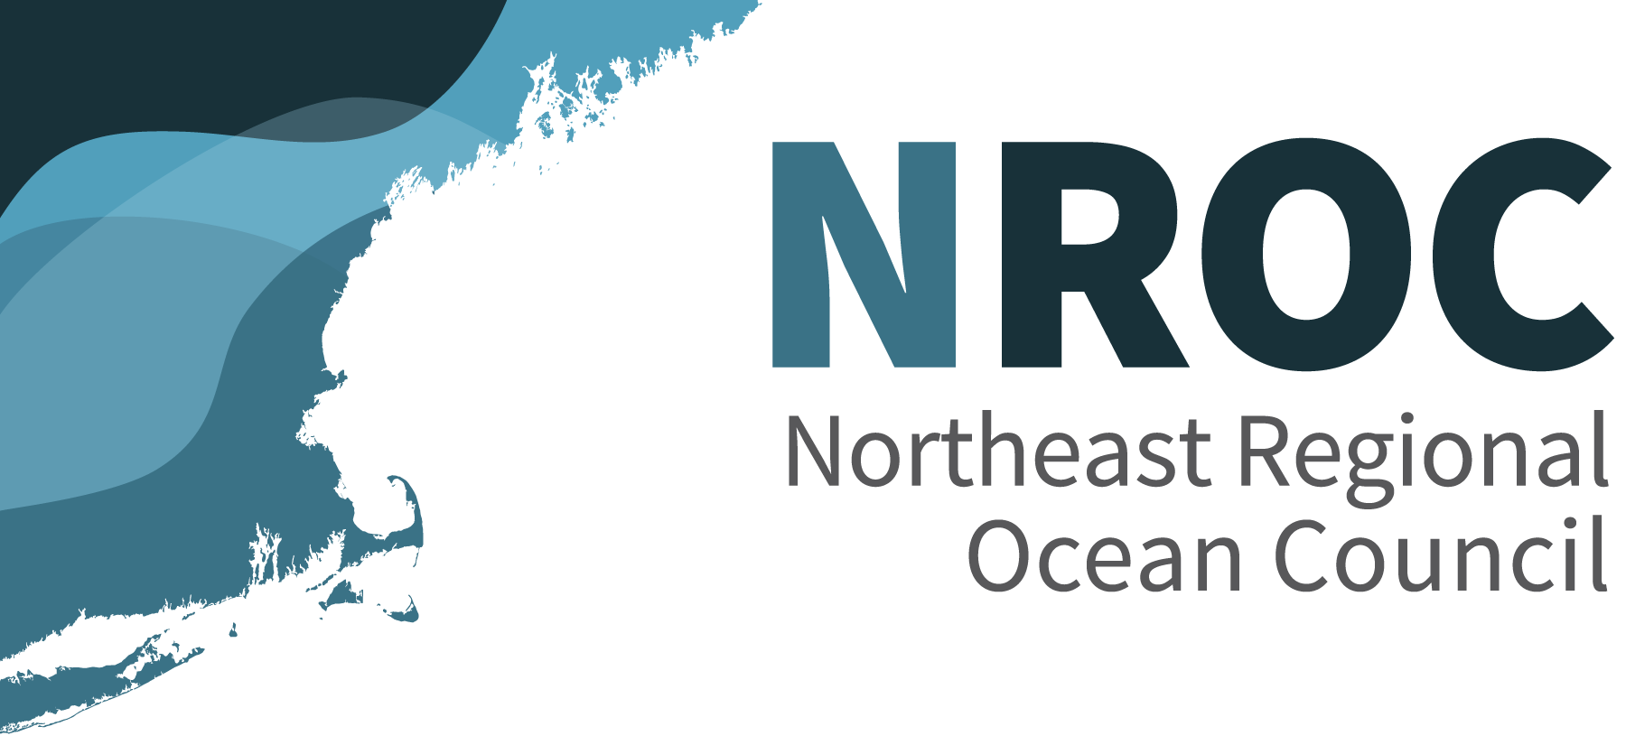
Governor Donald Carcieri (R), RI, proposed NROC to other New England Governors in April 2005
NROC Established in August 2005 by the New England Governors’ Conference to “facilitate the development of more coordinated and collaborative regional goals and priorities, and improve responses to regional issues”.
2005 New England Governors:
CT: Rell (R)
RI: Carcieri (R)
MA: Romney (R)
NH: Lynch (D)
ME: Baldacci (D)
VT: Douglas (R)

Slide 3
In 2007, the Governors made a joint appropriations request for NROC, including for seafloor mapping in the Gulf of Maine. It was sent to Senate/House Appropriations Chairs, the White House Committee on Ocean Policy, and the federal interagency Subcommittee on Integrated Management of Ocean Resources (SIMOR).
2007 New England Governors:
CT: Rell (R)
RI: Carcieri (R)
MA: Patrick (D)
NH: Lynch (D)
ME: Baldacci (D)
VT: Douglas (R)

Slide 4
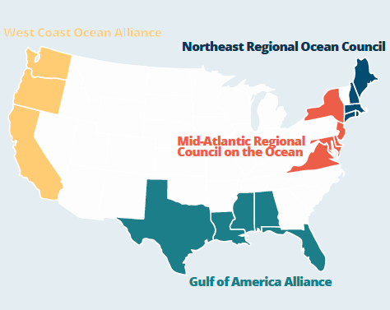
Regional Ocean Partnerships
EO 13840 on June 19, 2018, directs the federal interagency Ocean Policy Committee to “engage and collaborate, under existing laws and regulations, with stakeholders, including regional ocean partnerships, to address ocean-related matters that may require interagency or intergovernmental solutions”
In 2022, Regional Ocean Partnerships (ROPs) were authorized in the National Defense Authorization Act for Fiscal Year 2023 to serve as “intergovernmental coordinators for shared regional priorities” and to “receive Federal funding to conduct scientific research, conservation, and restoration activities, and coordination on shared regional priorities.”

