Slide 1
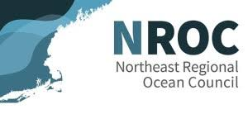
Northeast Regional Ocean Council Ocean Acidification Outreach
Stakeholder Engagement Update
NROC Spring Meeting
May 15th 2025

Slide 2
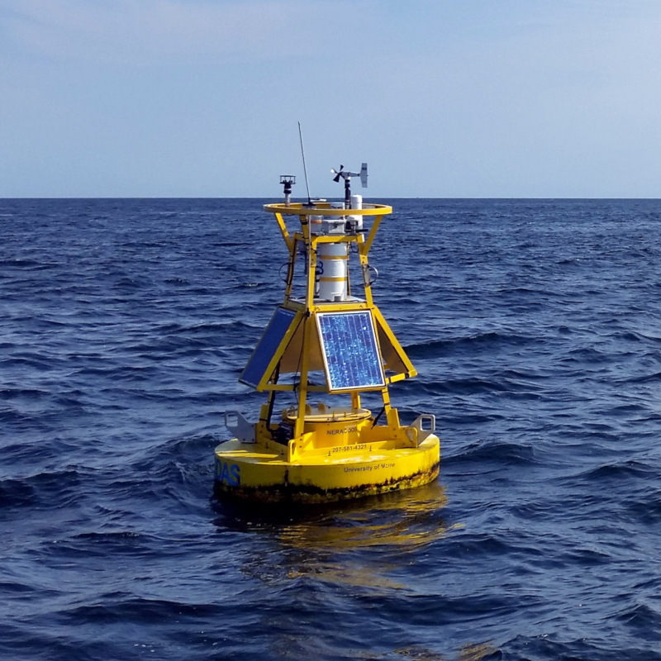
Ocean Acidification Monitoring in the Northeast
Robust data collection and monitoring of environmental variables associated with OA are essential.
NROC has played a leading role in supporting OA monitoring and management efforts in the region.
In November 2023, NECAN-NROC hosted workshop to identify priorities for understanding OA in the region and impacts.
Workshop outcomes served as basis for development of draft Ocean Acidification Monitoring Plan.

Slide 3
Development of Ocean Acidification Management Tools
NROC is prioritizing the development of an OA theme in the Northeast Ocean Data Portal.
Conducting outreach with scientists and managers to inform the development of OA theme.
Key findings related to data needs, species specific concerns, thresholds, regions of interest etc. will be key in developing this layer.

Slide 4
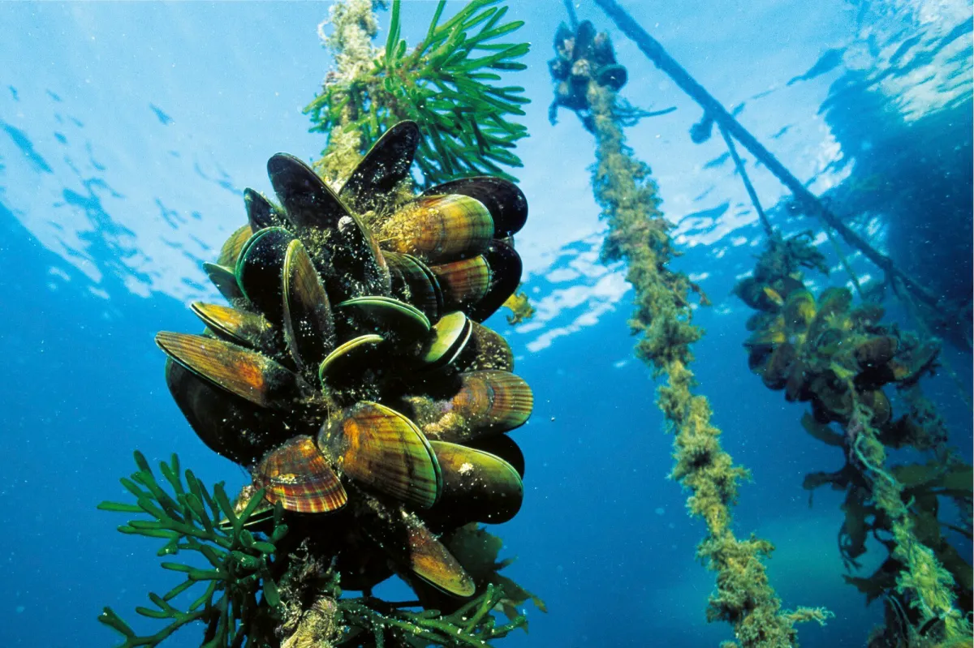
Stakeholder Engagement Update: Spring 2025
NROC began outreach in Spring 2025 with state coastal managers in Maine, New Hampshire, Massachusetts, Rhode Island and Connecticut.
Currently engaging representatives from SeaGrant programs in the region.
Shared overview of outreach with members of NROC Tribal Caucus, potentially host future webinar.
Engagement with regional scientists will take place following outreach to decision makers.

Slide 5
Stakeholder Outreach and Engagement: Regional Decision Makers
What are the species of concern as it relates to ocean acidification in New England for your program and why (i.e., lobsters, oysters, scallops, others).
What specific management/regulatory activities apply?
What types of maps, tools, or data products could help inform your agency’s engagement in those management activities? Specifically, information beyond the monitoring being conducted in specific locations – for example, maps of ocean acidification concentrations and risks to individual species sensitivity?
Have efforts been employed to map species and areas that are increasingly vulnerable to ocean acidification in New England? If so, who were these efforts carried out by? What types of data were collected to support their characterization as vulnerable? Where are these data/products stored?
Anything additional you want to discuss related to management needs? Are there others in your state/agency we should engage?

Slide 6
Stakeholder Outreach and Engagement: Management Needs and Priorities
Overview of species concerns, management needs and recommended data products to inform decision making:
Species of importance include American lobsters, oysters, clams (softshell, quahog/hard, razor, Atlantic surf clam), mussels, seagrass, eel grass, squid, forage fish species, sand lance and bay anchovies.
It would be useful if NROC is able to map the regional extent of ocean acidification risk and identify habitats that might be at risk.
Developing features that allow users and decision makers to know the spatial extent of ocean acidification hot spots (i.e., pinpoint areas where ocean acidification is occurring, the time scale of occurrences, localized areas that experience higher than average ocean acidification).
Also useful are products that help inform aquaculture site selection (i.e., beneficial when identifying new shellfish growth in more near-offshore sites owing to saturation of nearshore sites, technology permitting).
Data products that can help outline the effects of ocean acidification in most important growing areas (i.e., it would be valuable to have a measure of coastal acidification that overlays natural beds and other important growing areas).
Mapping the extent of ocean acidification can help improve development of mixed trophic aquaculture techniques and understanding impact of parasites in growth areas.

Slide 7
Stakeholder Engagement: Reporting and Next Steps
Following engagement with states, Tribes, scientists and industry representations, NROC will compile responses into a report which will be published in fall 2025.
The findings documented in this report will include:
Series of key recommendations
Summary of what we heard
Agencies/organizations listed (no name specifics).
If you would like to provide feedback or recommend an entity that we should engage, please let us know!

Slide 8
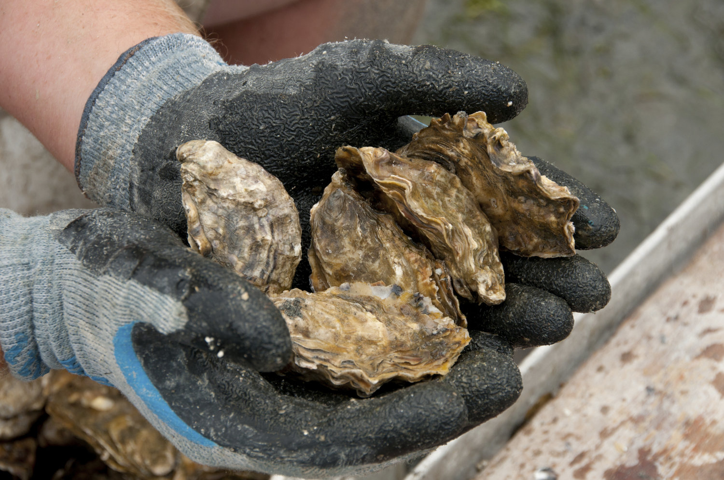
Contact Information Nikelene Mclean, NROC/RWSC Habitat and Ecosystem Subcommittee Coordinator mcleannikelene@gmail.com Amy Trice, Senior Program Director Northeast Regional Ocean Council atrice@northeastoceancouncil.org Emily Shumchenia, Science Lead, Northeast Regional Ocean Council Emily.Shumchenia@gmail.com
Questions/Feedback?

