Slide 1
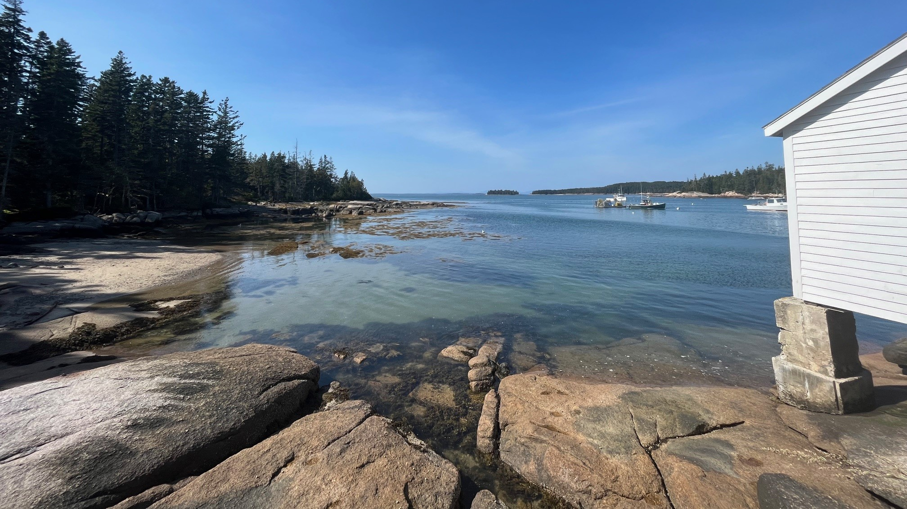
Implementing Maine's Climate Action Plan through Innovation in Municipal Training and Technical Assistance (TA)
Rachael Hamilton (she/her)
NOAA Coastal Management Fellow ‘25
May 15, 2025
Stonington, ME. Credits: Maine Coastal Program

Slide 2
Project Goal
1) To design, pilot, and evaluate a TA program that increases community resilience to coastal hazards.
2) To build local capacity for implementing Maine Won't Wait by equipping municipalities with tools, training, and TA on coastal hazards.
Notes:
Some of you in this room may be familiar with my project, and if you have an awesome memory, unlike myself, may even remember that I presented a year ago here at NROC! Since a catch-up is necessary, but could be dull and repetitive for some, I thought we would play a game to recall some major details around the project that I am presenting on today!

Slide 3
Defining Resilience
1) Minimal disruption to public and private property, daily business operations, and vital social and community services.
2) Ability of a community to prepare for, adapt to, and recover from disasters like storm surge, flooding, and sea level rise.

Slide 4
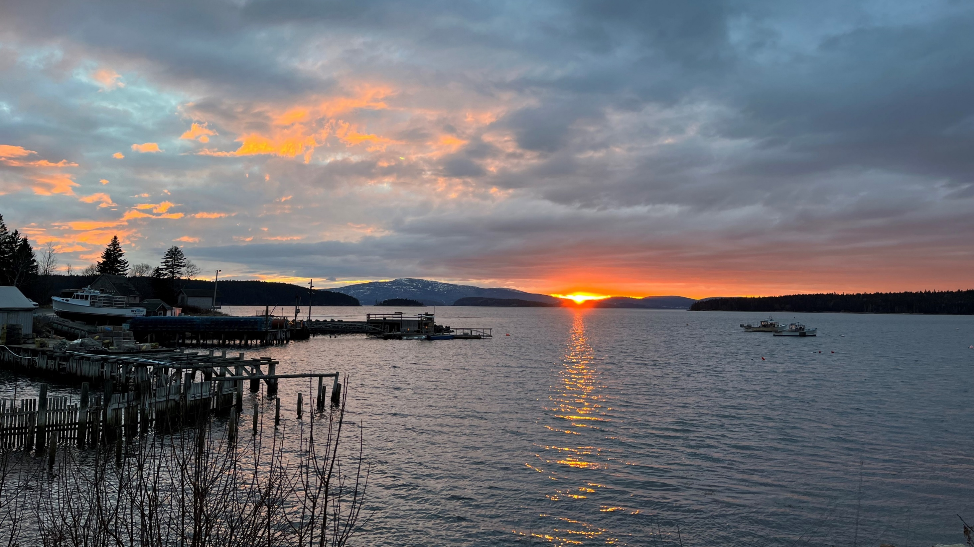
To design, pilot, and evaluate a technical assistance program that increases community resilience* to coastal hazards.
*Defined as: Minimal disruption to public and private property, daily business operations, and vital social and community services from events such as storm surge, flooding, sea level rise.
Notes:
In summary, the project proposal I received from my mentor was this, which I interpreted as something like, “you need to solve all of our climate resilience problems” – yikes!

Slide 5
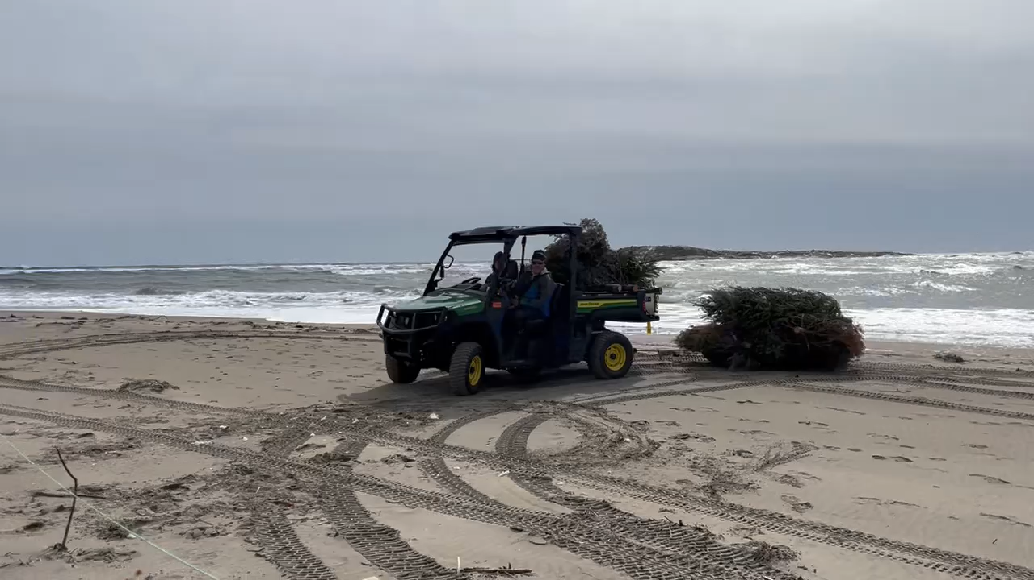

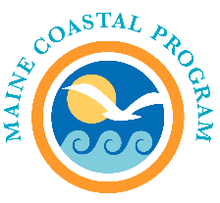


Rachael Hamilton
NOAA Coastal Management Fellow
Popham Beach, Maine. Credits: Maine Coastal Program
Notes:
So, with that foundational knowledge, I’m Rachael Hamilton with the Maine Coastal Program, and I help communities increase resilience and decrease impacts from coastal hazards.
Also, did anyone recognize the cameo driving the gator?

Slide 6
Did I achieve the project goal?

Slide 7
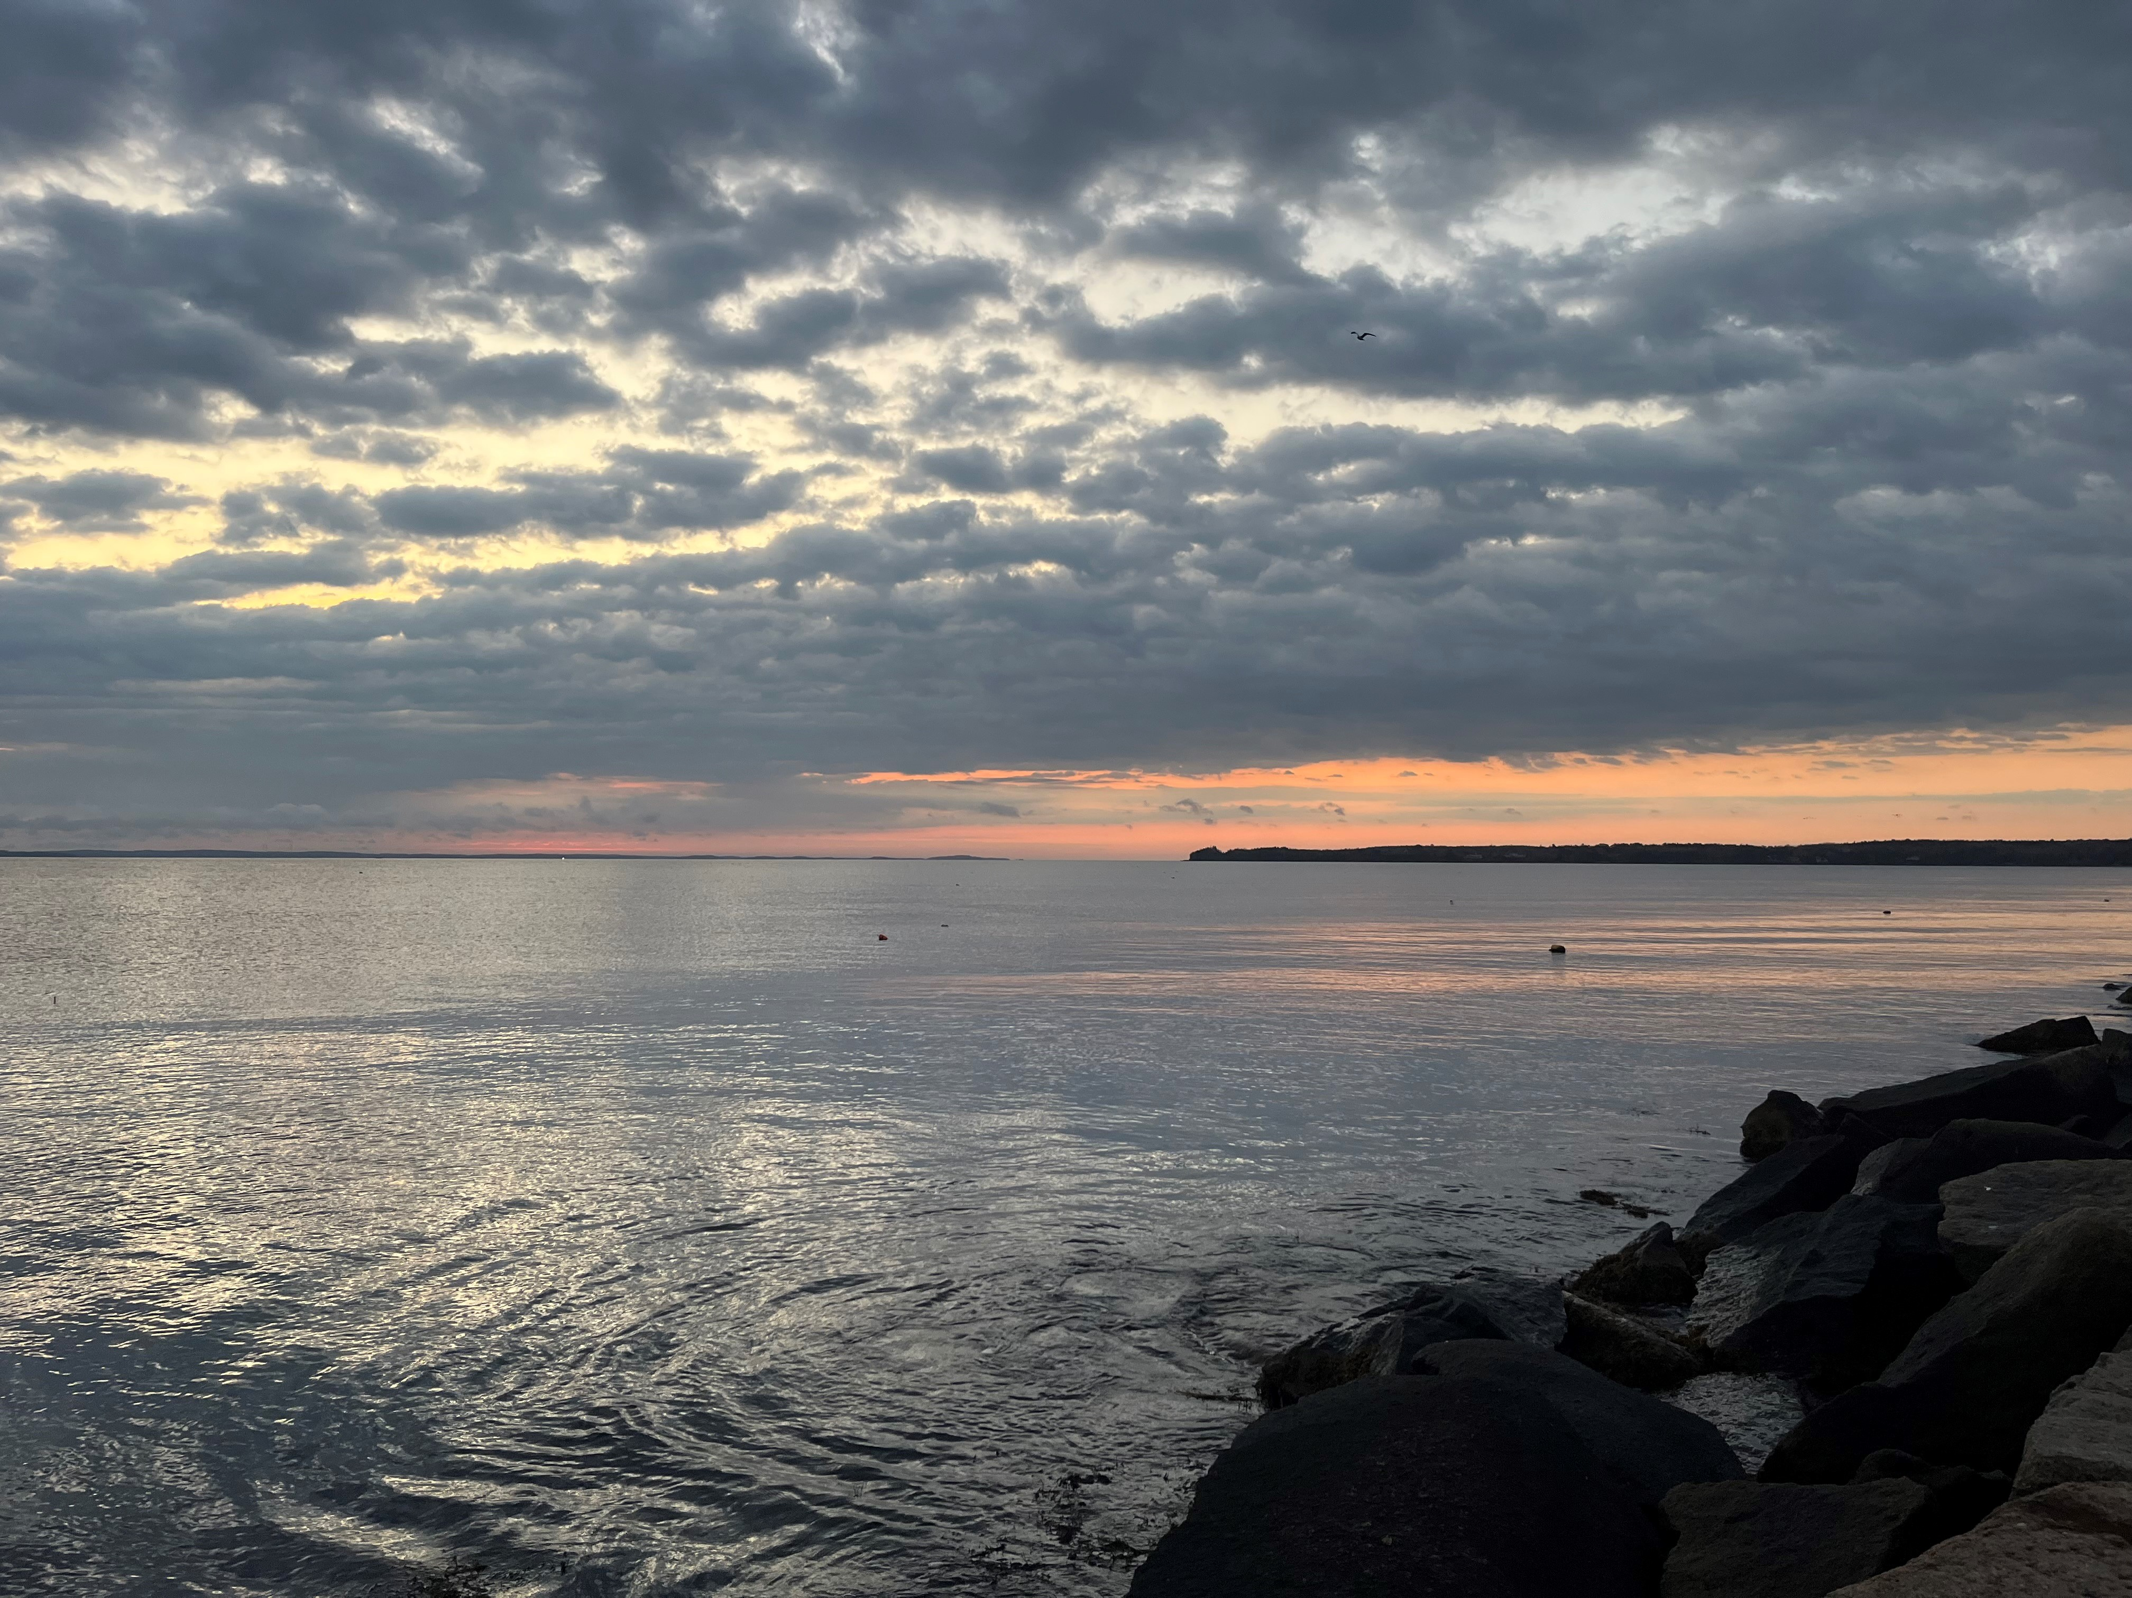
I designed, coordinated, and evaluated the Natural Hazards and Land Use Planning 101 series to deliver TA on flooding, erosion, and wildfire, to municipal staff and committees in Maine.
Rockland, ME. Credits: Maine Coastal Program

Slide 8
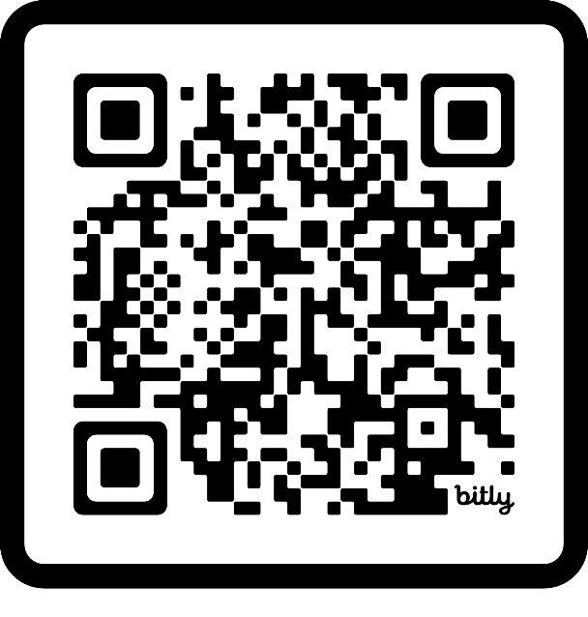
Natural Hazards and Land Use Planning 101
1. Introduction to Natural Hazards and Land Use Planning
2. Assessing Risk from Natural Hazards
3. Connecting Community Planning to Hazard Mitigation Planning
4. Land Use Planning Strategies for Risk Reduction
5. Funding and Financing Hazard Resilience
6. Demystifying Nature-based Strategies
Notes:
We created a replicable TA series that acts as one-stop shopping for natural hazards planning that Maine communities are most at risk of. You can scan this QR code to take you to the state website with the series. It is a 6-part series that follows the process a community would take from knowing their hazards, planning for them, and implementation. The original series took place from August 2024 through February 2025 and all the sessions are recorded and uploaded to the MPAP website. On the website there is a session summary for each workshop, with presenter contacts listed, and any additional resources uploaded as well.
Meant to be introductory & high-level, but highly tailorable for a more targeted audience. It draws on resources, tools, data, and subject matter experts who are working in Maine beyond my fellowship.

Slide 9
Outcomes
Project Design
Process
Relationships
Notes:
So, you already know the outcome, being the series. What I wanted to dive into a little further, and which may have the most relevance to this room, is the project design process and relationships built that enabled me to have such a successful outcome. And how my fellow TA providers and project leads in this room can also follow a similar process.

Slide 10
You can create a TA program for community, by community:
Facilitating community-led decision-making
Developing partnerships
Enabling transferability
Rockland, ME. Credits: Maine Coastal Program
Notes:
You too can create a TA program for community, by community:
Facilitating community-led decision-making
Building partnerships
Enabling transferability

Slide 11
1. Facilitating community-led decision-making

Slide 12
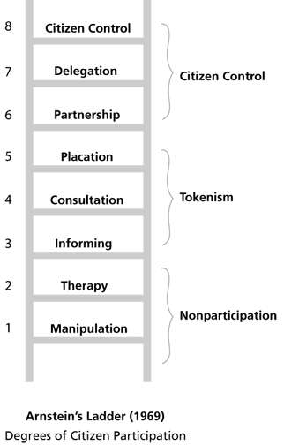
Community
Community
Community
Notes:
*This was designed in 1969, want to acknowledge not all members of a community are citizens.
*Also, many of the rungs 1-5 are not necessarily bad strategies, and in fact, when combined with several approaches, are a legitimate and important step to empowerment in the hands of those these decisions are impacting.
1 & 2 = Presenting an illusion that people have power, but really just having them agree with decisions already made by those who currently hold power.
3 & 4 = One-way flow of information, or taking feedback after everything has already been done, so people have no control over decisions being made.
5 = Maybe adding someone to an advisory committee solely based on their characteristics, as a show of “we care” but not taking into consideration the entire community they are meant to represent. In addition, they may be outnumbered etc. This person also needs to be invited or deemed worthy enough to be invited in the first place, and again invited by those who hold a certain level of power.
6-8 = More genuine forms of community empowerment. Partnership tends to occur in the beginning of a project development, alongside a group of many, and work together to set objectives, goals, and take action. Delegation gives up some power to the partnering group, and citizen control gives them full power. For example, if there is a budget, citizen control is when that community has a board with full control over the budget and decision-making of how it is used.
In my fellowship, I may not be able to achieve rung 8, but I could certainly achieve rung 6.

Slide 13

Capacity
Notes:
With this theory in mind, I went on to attend many a meetings, and I listened, and I learned.
I kept hearing capacity as a barrier to implementing coastal resilience. The town manager is also the code enforcement officer and planner. They clean the public restrooms by day and run the town meetings by night.
HEARING capacity as a major challenge and genuinely respecting that

Slide 14
Identify contacts with existing relationships and trust who can speak on behalf of those you want to serve.
Notes:
… meant identifying contacts_
THIS is a key practice in equitable engagement. Ensures you are not mistakenly burdening the same people you are trying to serve or support.

Slide 15
Skills(?)
Topics
Notes:
Since interfacing directly with communities was not the way to build a relationship, I identified active service providers in Midcoast Maine who had close relationships with and knowledge of community TA needs and conducted a needs assessment with these individuals. There was about 30 of them.
Service providers filled in a survey in advance, and I summarized those results. During the meeting I had folks vote via Mentimeter for their top 3 needs from the list. That way they could see publicly what were the most popular needs, so they felt acknowledged and part of the process, even if their suggestions didn’t rise a top need.
This took place a few months after the major 2023 and 2024 winter storms that hit the Northeast, and the role of emergency management in building resilience really rose in discussion.

Slide 16
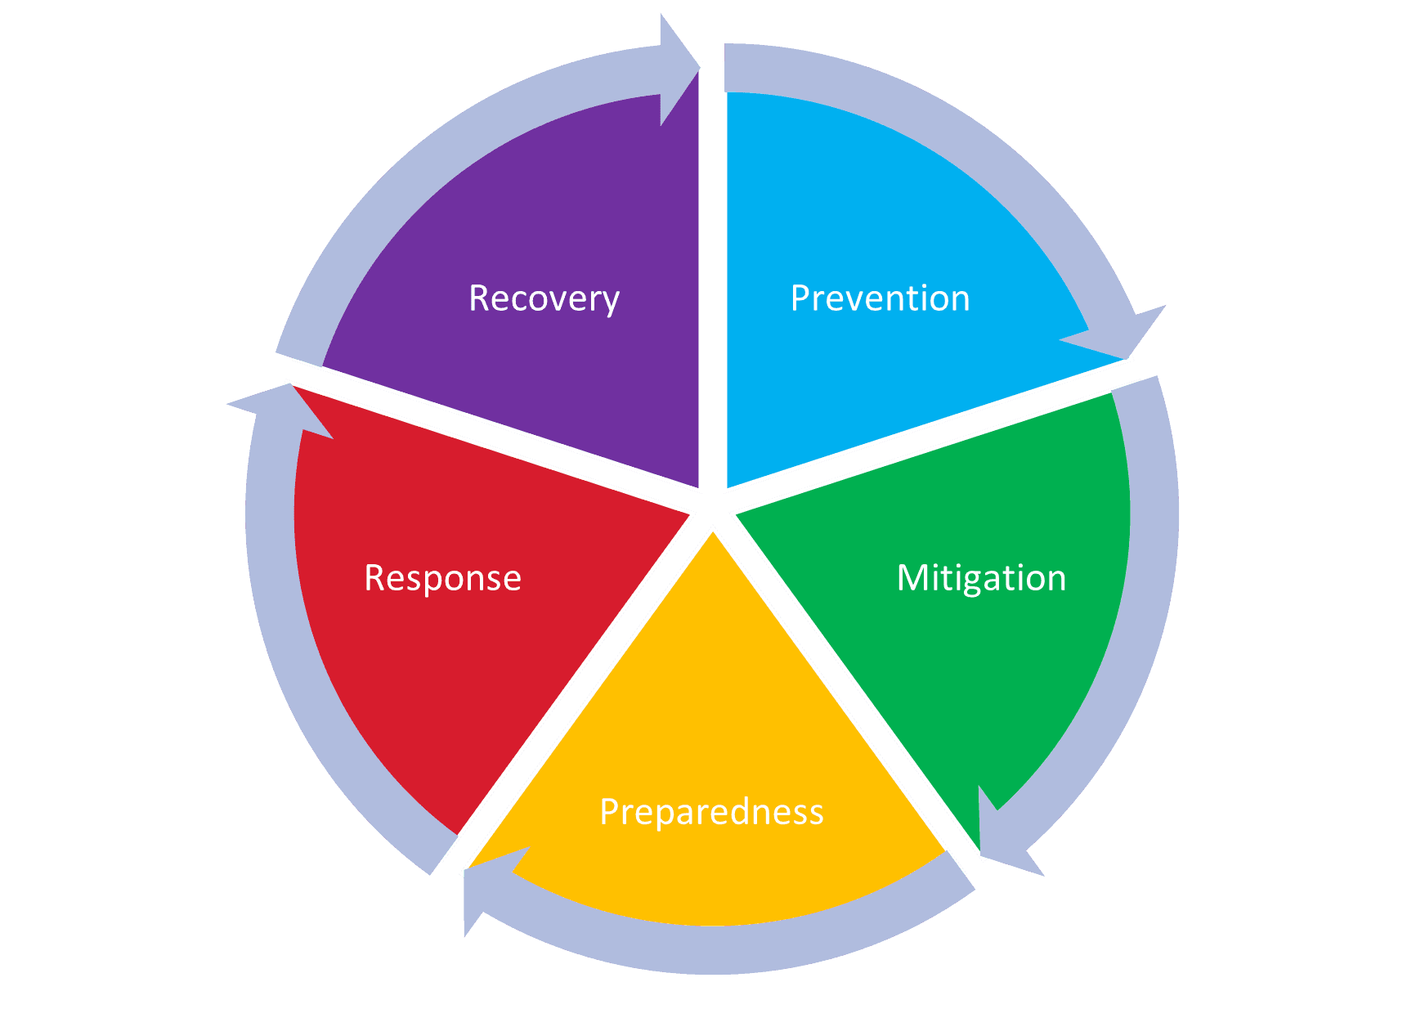
Planners
Emergency managers
Notes:
In emergency management, emergency managers, directors, and responders spend much of their time planning for when a disaster happens and how to respond and recover from it.
That leaves a much-needed gap in prevention and mitigation, which requires planning to reduce the impacts of those disasters before they happen.

Slide 17
Hazard Planning
Social
Political
Cultural
Environmental
Economic
Notes:
Hazard planning is an effective topical area to incorporate climate resilience actions. BUT it requires cross collaboration. How do we reach folks who may not identify with this resilience crowd as much, but play a major role in it? This is a moment where I could balance my professional judgment with the voices of those I am intending to serve.

Slide 18
2. Developing partnerships

Slide 19
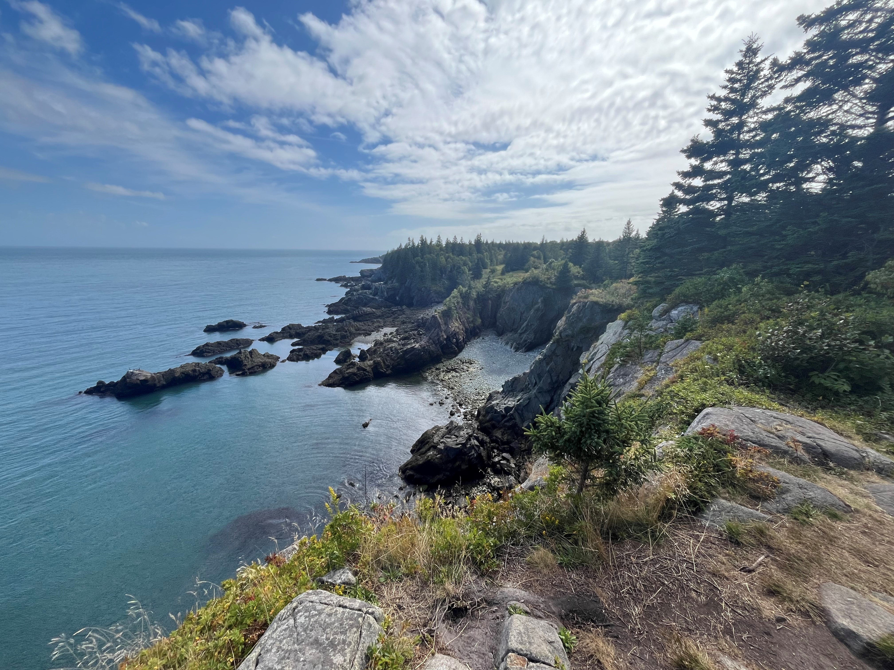
What do you do that could be made into a TA program that would make your job easier?
Cutler, ME. Credits: Maine Coastal Program
Notes:
One thing I did that resonated well, was asking subject matter experts and service providers, what do you do….
The goal was to communicate clearly that I am here to add value to your work, I am not here to compete with you, and I want to support you in the relationships that you already have. I just want to make your job a little easier.
I know this TA isn’t going to solve everything, or eliminate the need for service providers and subject matter experts, but it can provide some relief from repetitive basics. Of course, there is still the need for guided discussion.

Slide 20






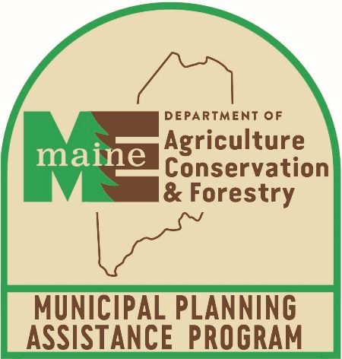





Notes:
So in maintaining follow-through and building relationships. I collaborated with these partners to develop the natural hazard planning series. And this doesn’t even include many additional featured guest speakers throughout the series. I asked folks what their capacity is to be involved, we set objectives together, or I just kept them apprised of what was going on. And we followed through.

Slide 21
3. Enabling transferability

Slide 22
Spoiler Alert

Slide 23
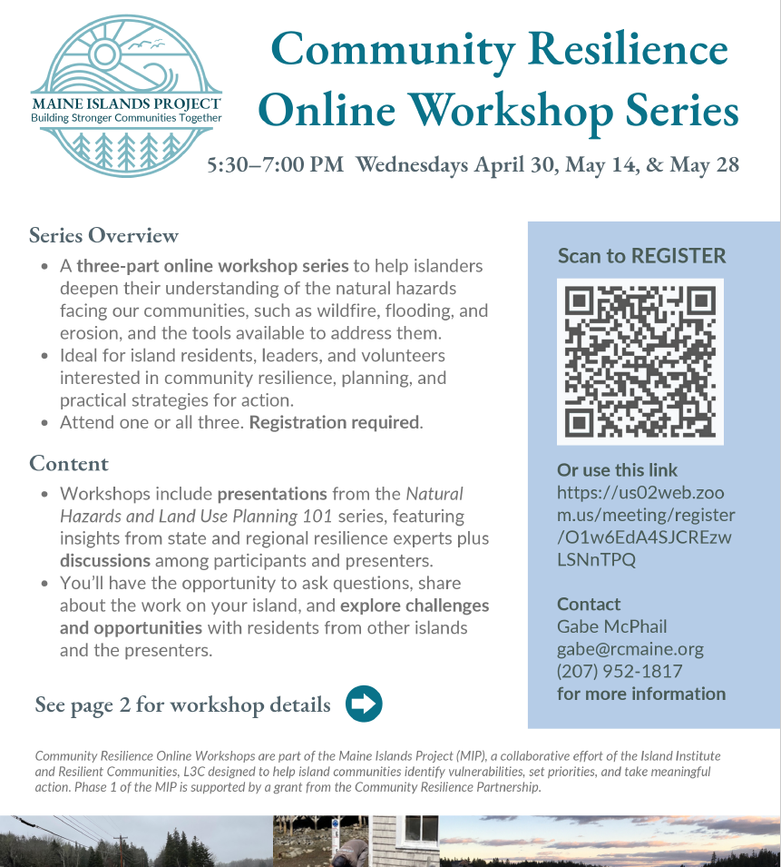
Notes:
It felt like Maine, made by Mainers, for Mainers.
Show how it is replicable (Abby & Gabe)
Intimate (30) group of community members, residents, staff from only island communities.
Guided discussion with questions, casual and interactive with audience.
All contacts are listed for each session, pick and choose at it suits your communities
Selected 3 sessions that were most applicable to where their communities are at and invited several speakers from each of those sessions to present again and answer questions live.
Interchange natural hazards for another topic, the structure is there, just change out the subject matter experts

Slide 24
You can create a TA program for community, by community:
Facilitating community-led decision-making
Developing partnerships
Enabling transferability
Rockland, ME. Credits: Maine Coastal Program
Notes:
You too can create a TA program for community, by community:
Facilitating community-led decision-making
Building partnerships
Enabling transferability

Slide 25

Rachael Hamilton
NOAA Coastal Management Fellow
Maine Coastal Program &
Bureau of Resource Information and Land Use Planning
Rachael.Hamilton@maine.gov
(207) 215-5197
Notes:
Questions I can ask the audience to prompt discussion [could make something interactive, word map, menti]
Any communities you have in mind that you can use this for/would benefit from engaging in this kind of interdisciplinary work
What is missing that would help it be more applicable

Slide 26
Natural Hazards and Land Use Planning 101
1. Introduction to Natural Hazards and Land Use Planning
2. Assessing Risk from Natural Hazards
3. Connecting Community Planning to Hazard Mitigation Planning
4. Land Use Planning Strategies for Risk Reduction
5. Funding and Financing Hazard Resilience
6. Demystifying Nature-based Strategies
Notes:
LEARNING LESSON: But very important here, achieving agreement typically means concessions will have to be made. Staying true to my community led process, I knew it was not going to be the community voice that has to compromise.

Slide 27
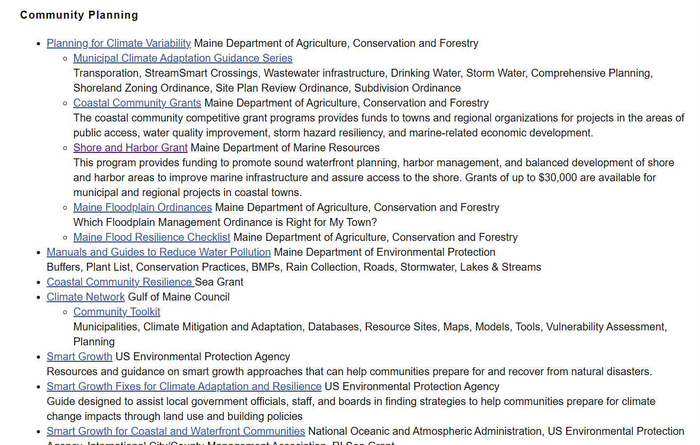
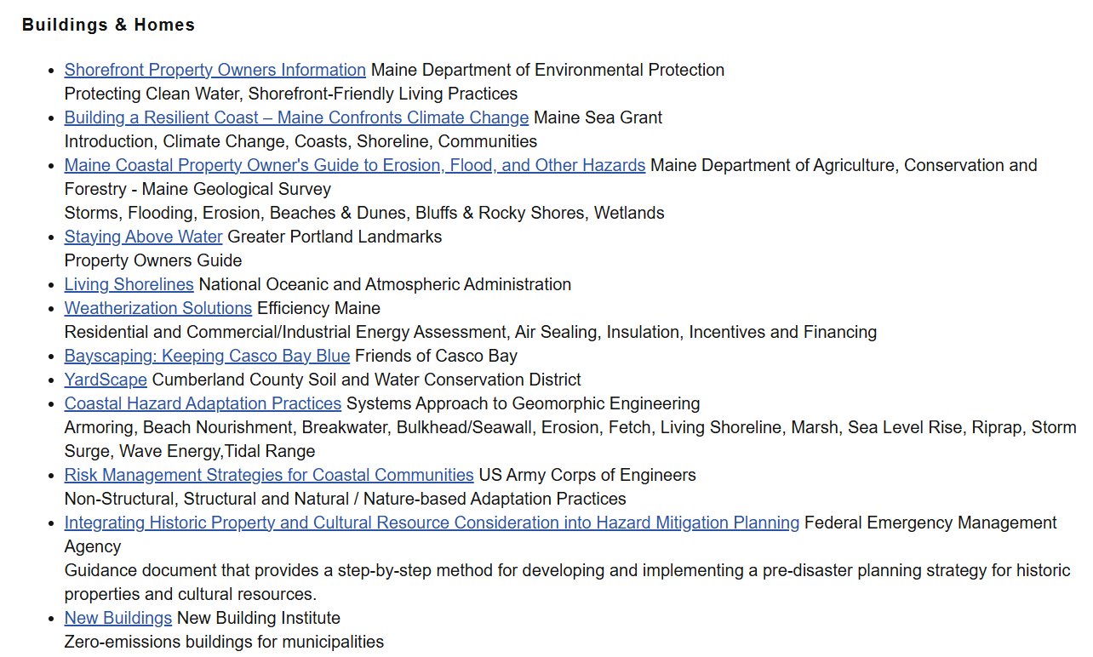
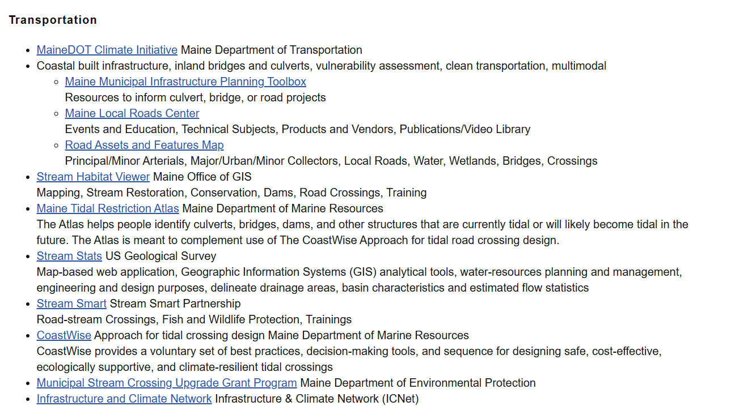
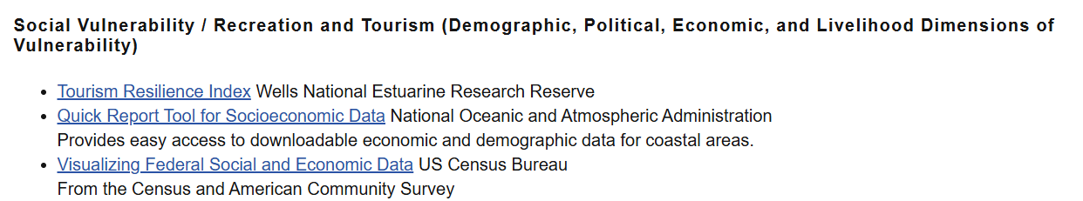
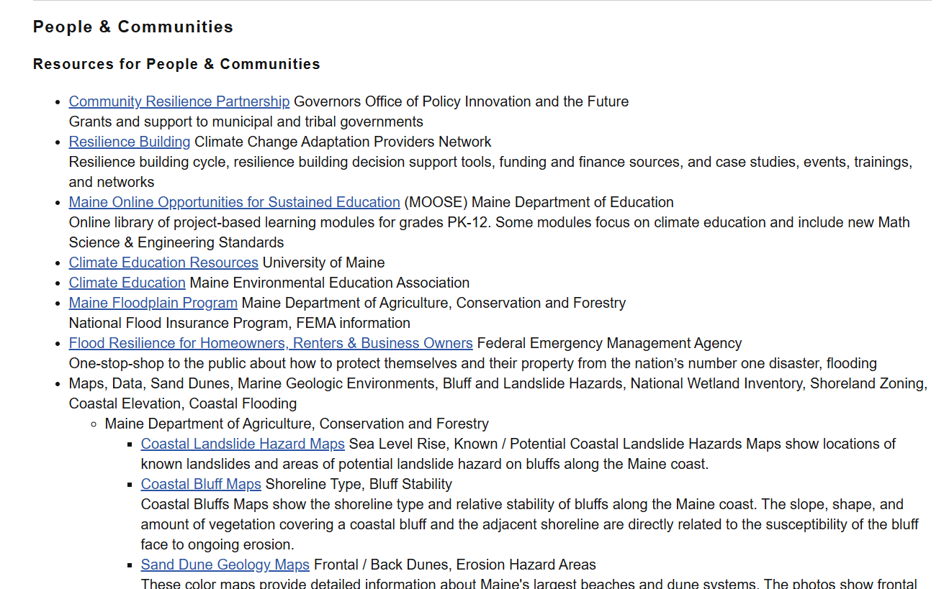
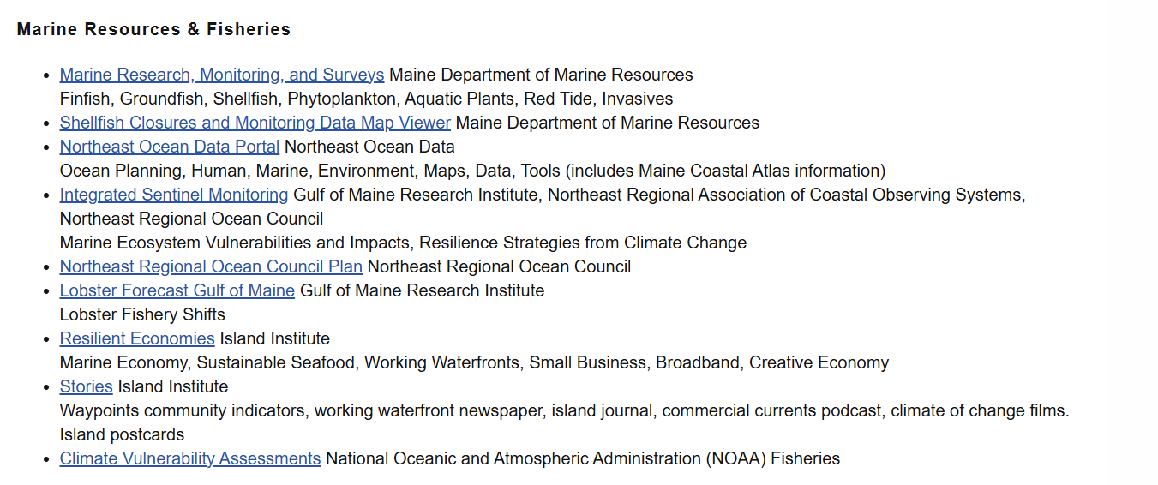
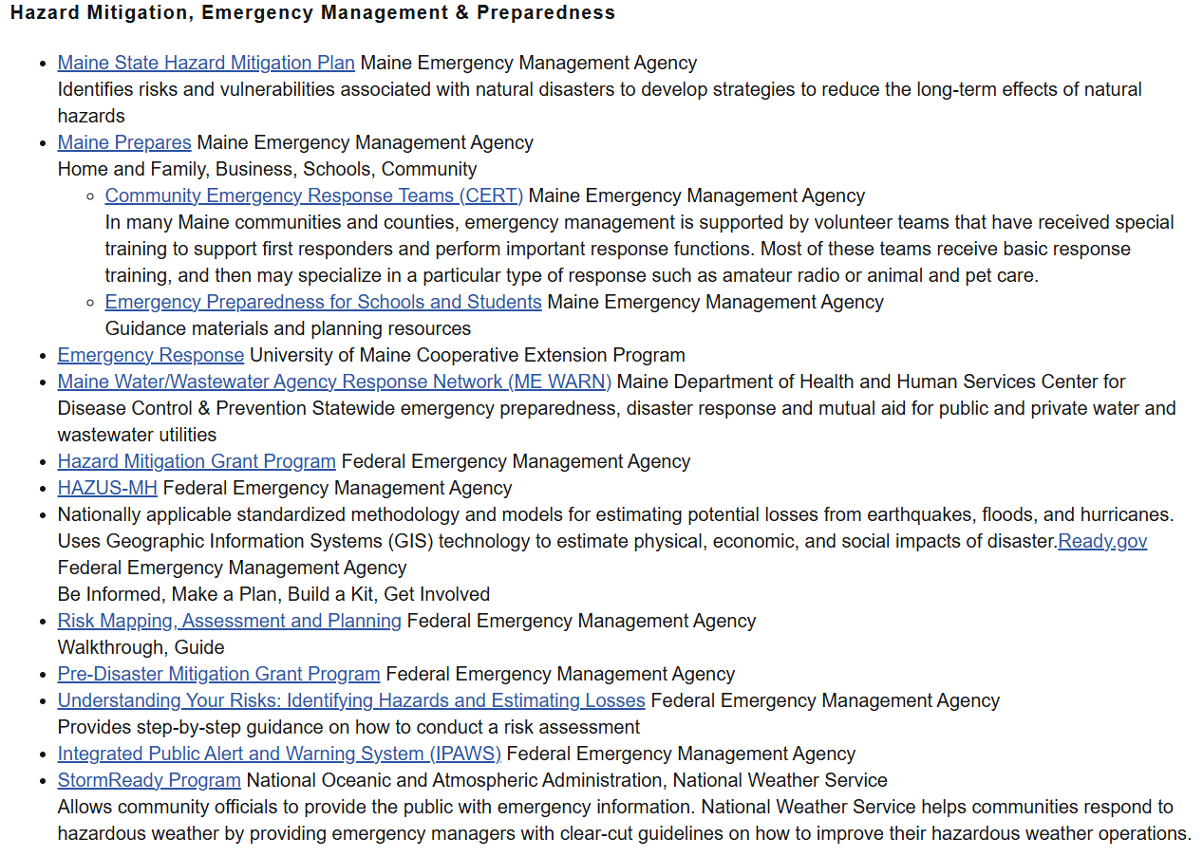
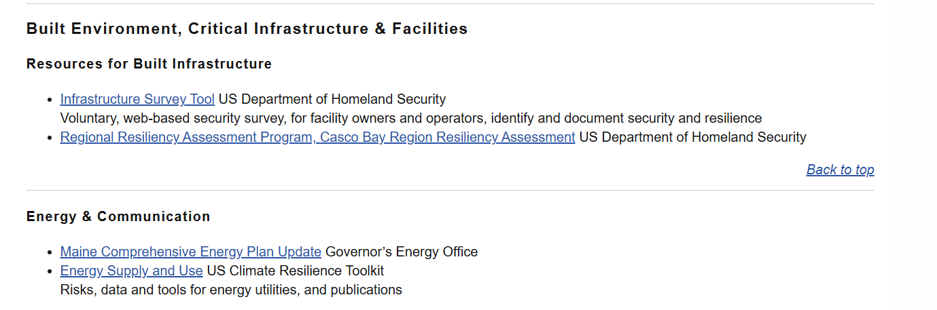
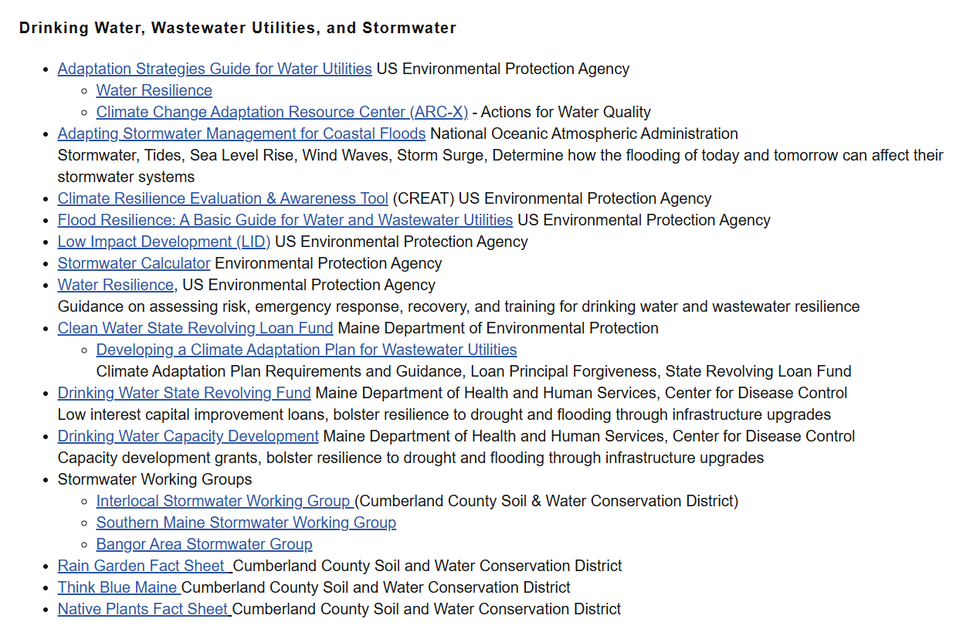
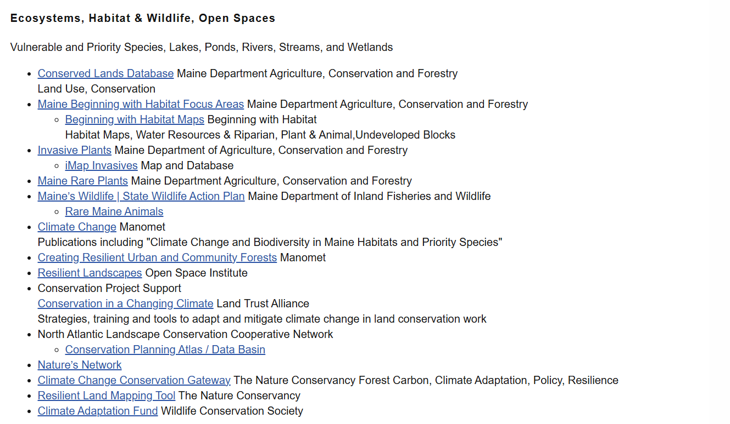
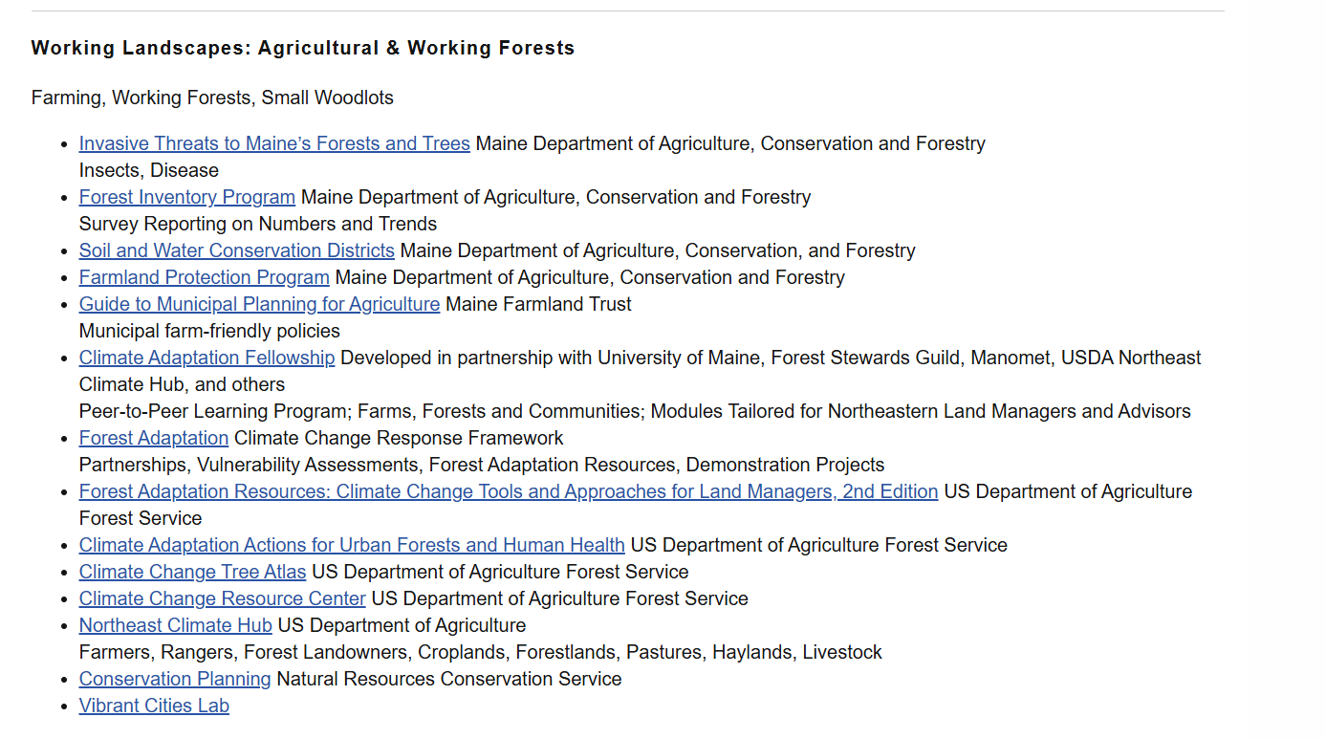
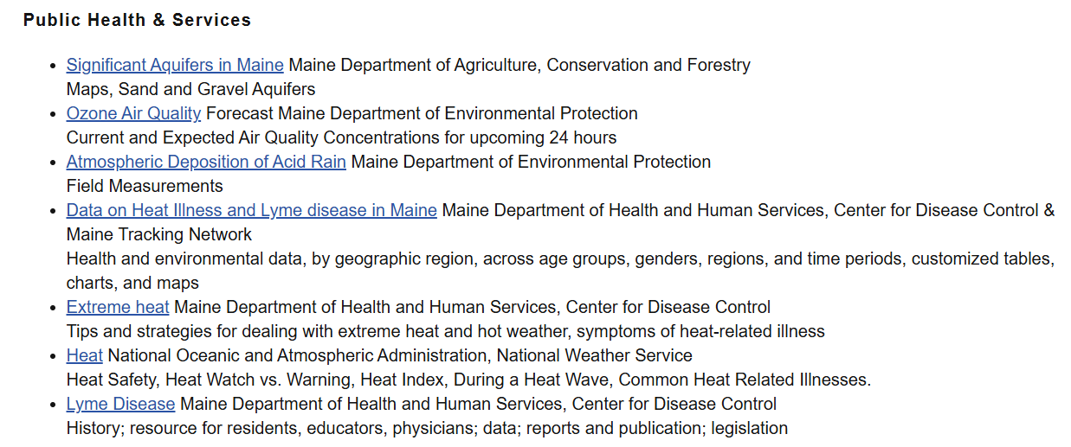
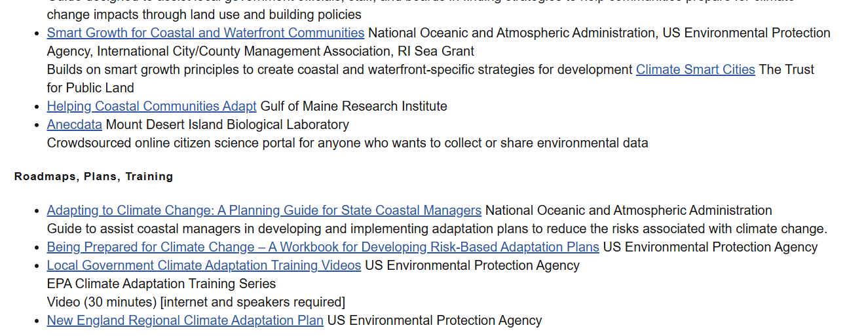
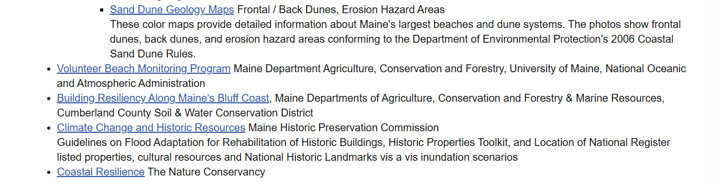
Notes:
There are many subject matter experts in Maine working in those areas, producing resources, data, and tools to support communities in adaptation and hazard resilience.
The nature of an interdisciplinary issue, like hazard planning, means users have to draw on all these resources. But it can be overwhelming to track down resources across agencies and coordinate amongst folks.
And like all of us in this room, the folks producing these resources are busy, and often end up siloed in their field or expertise, with not enough time to coordinate between groups.
Of course, I don’t mean to preach to the choir, just want to set you all up for what I heard and what I addressed.

