Slide 1
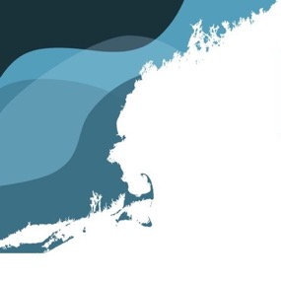
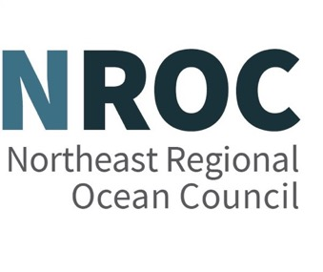
Northeast Ocean Data Portal Redesign
May 15, 2025

Slide 2
Northeast Ocean Data Portal Team
Nick Napoli, NROC Executive Director
Amy Trice, NROC Senior Program Director
Emily Shumchenia, NROC Science and Portal Director / RWSC Director
Jenna Ducharme, Jeremy Fontenault, Stephen Sontag, Kevin Martin, and Kelly Knee – TetraTech
Peter Taylor, Waterview Consulting

Slide 3
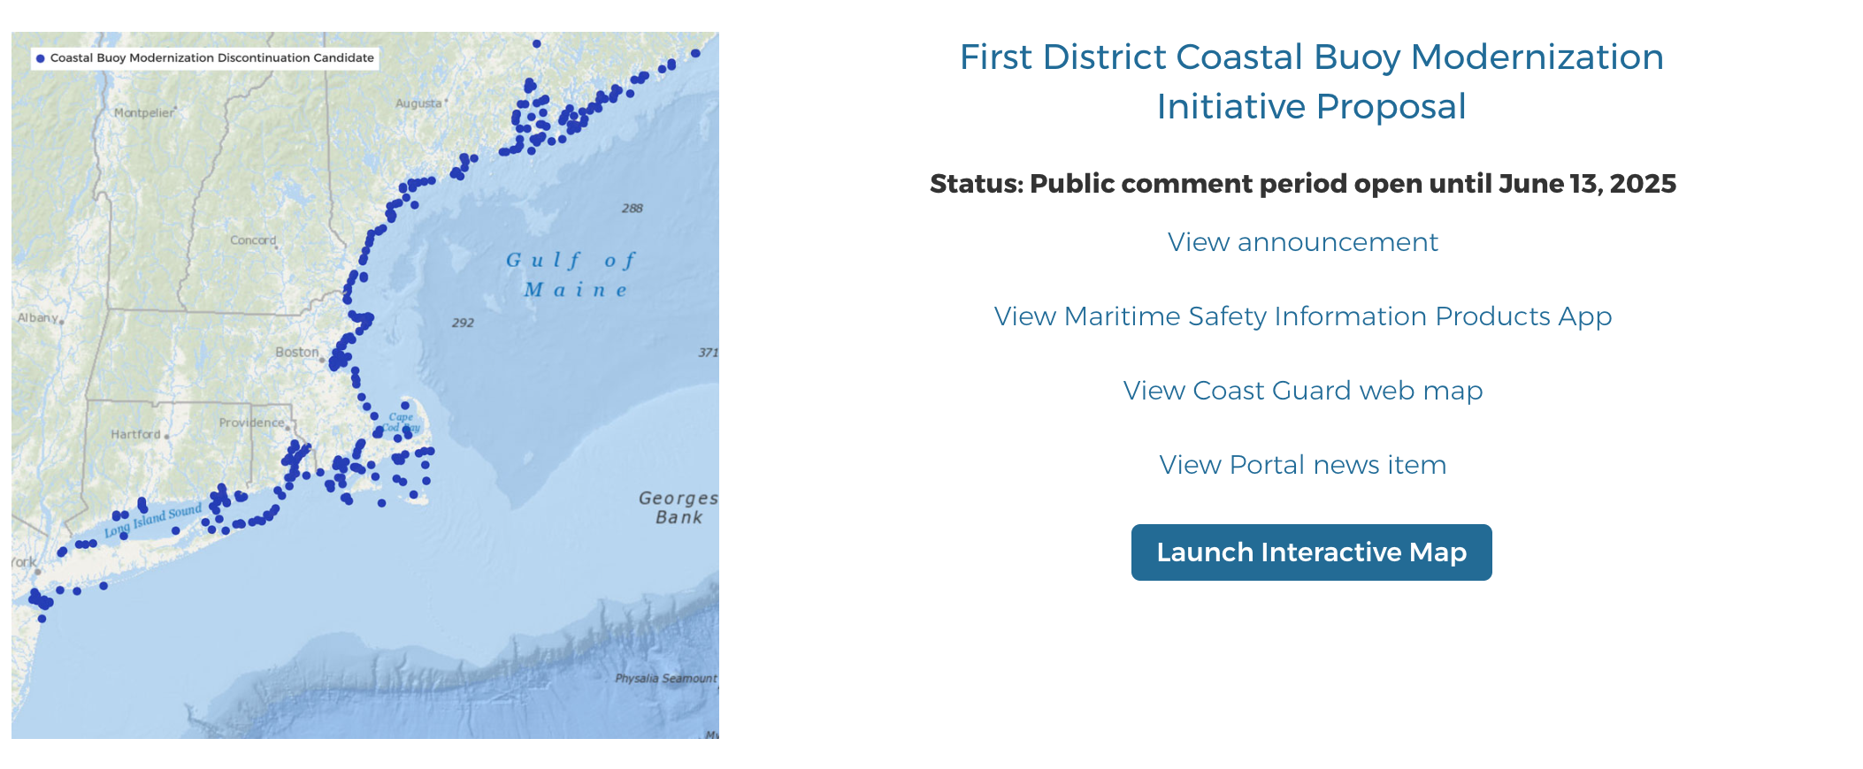
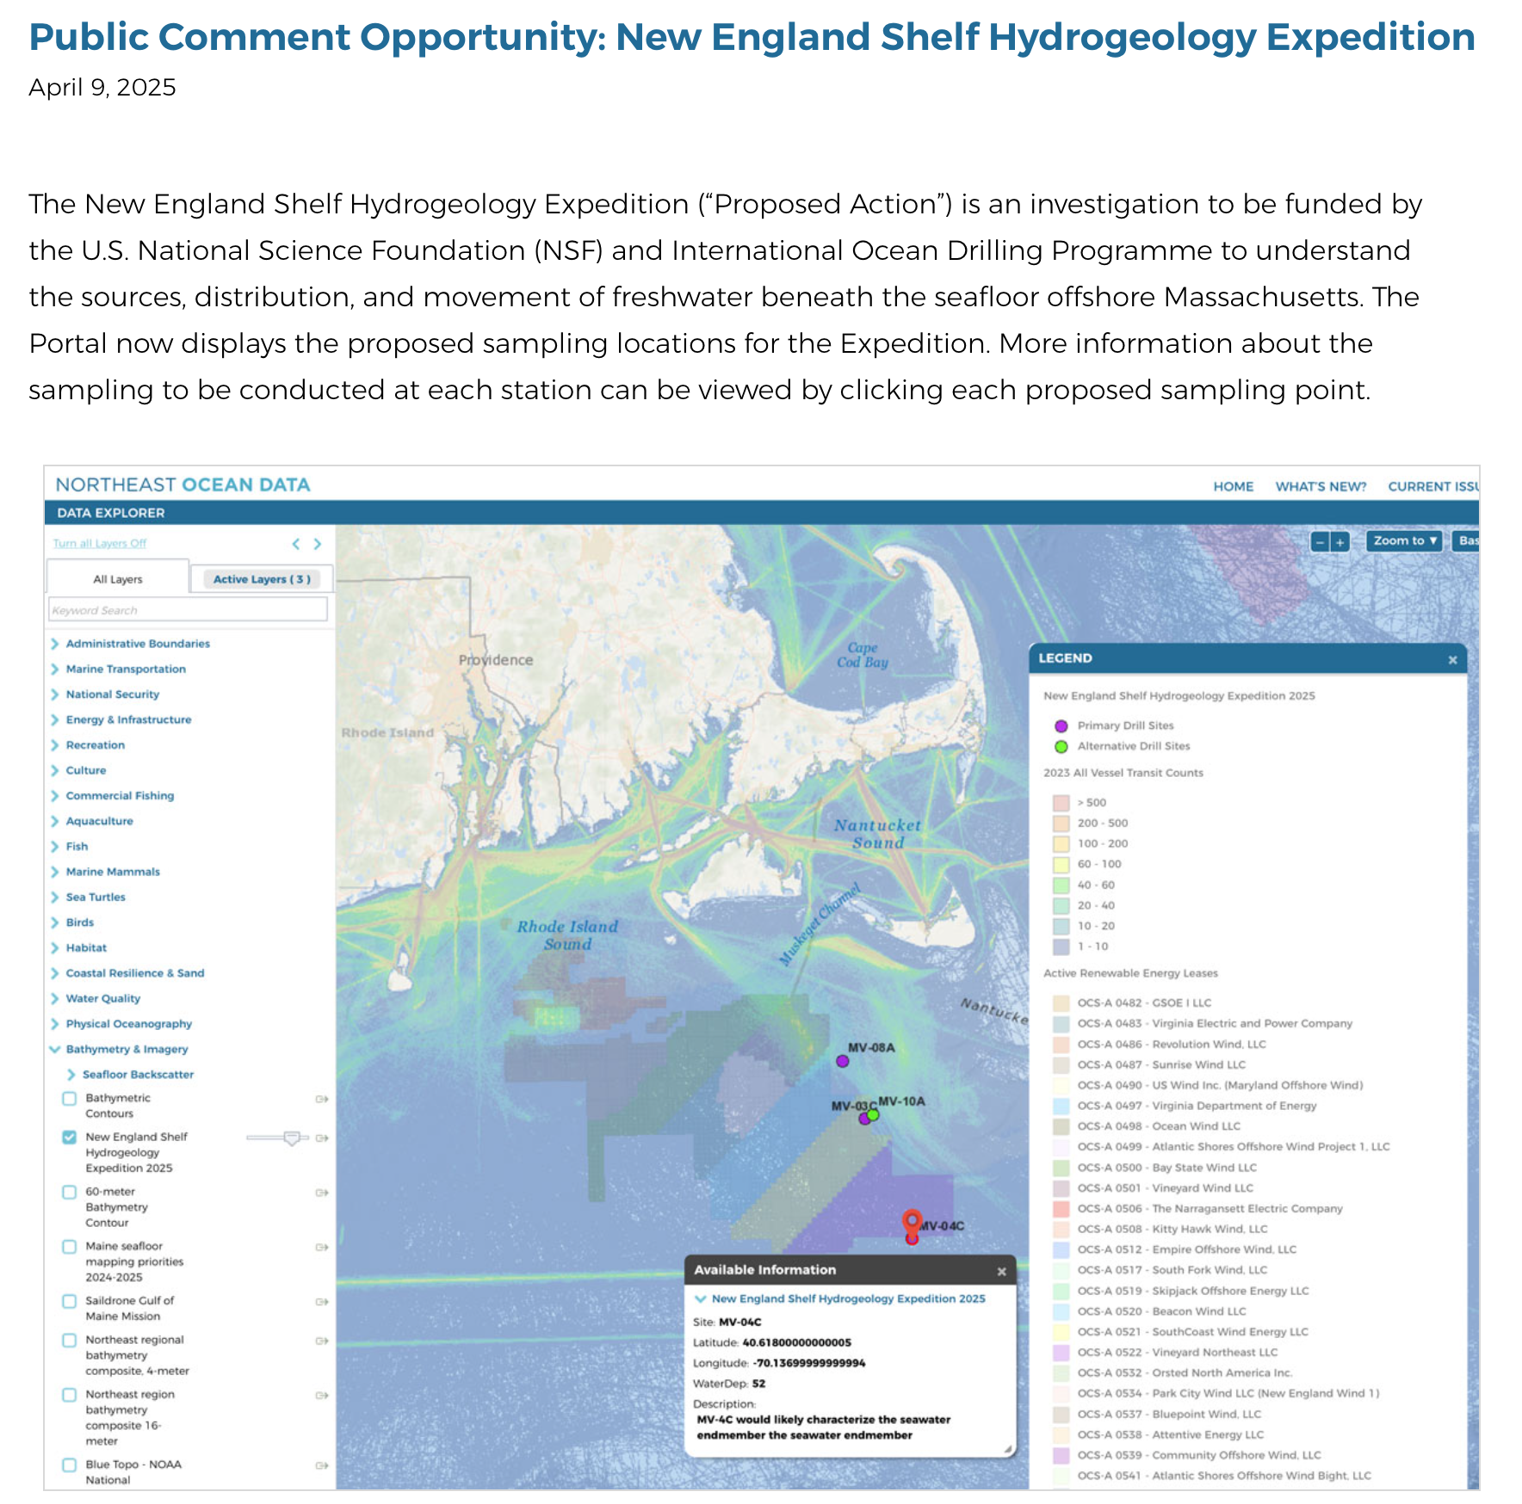
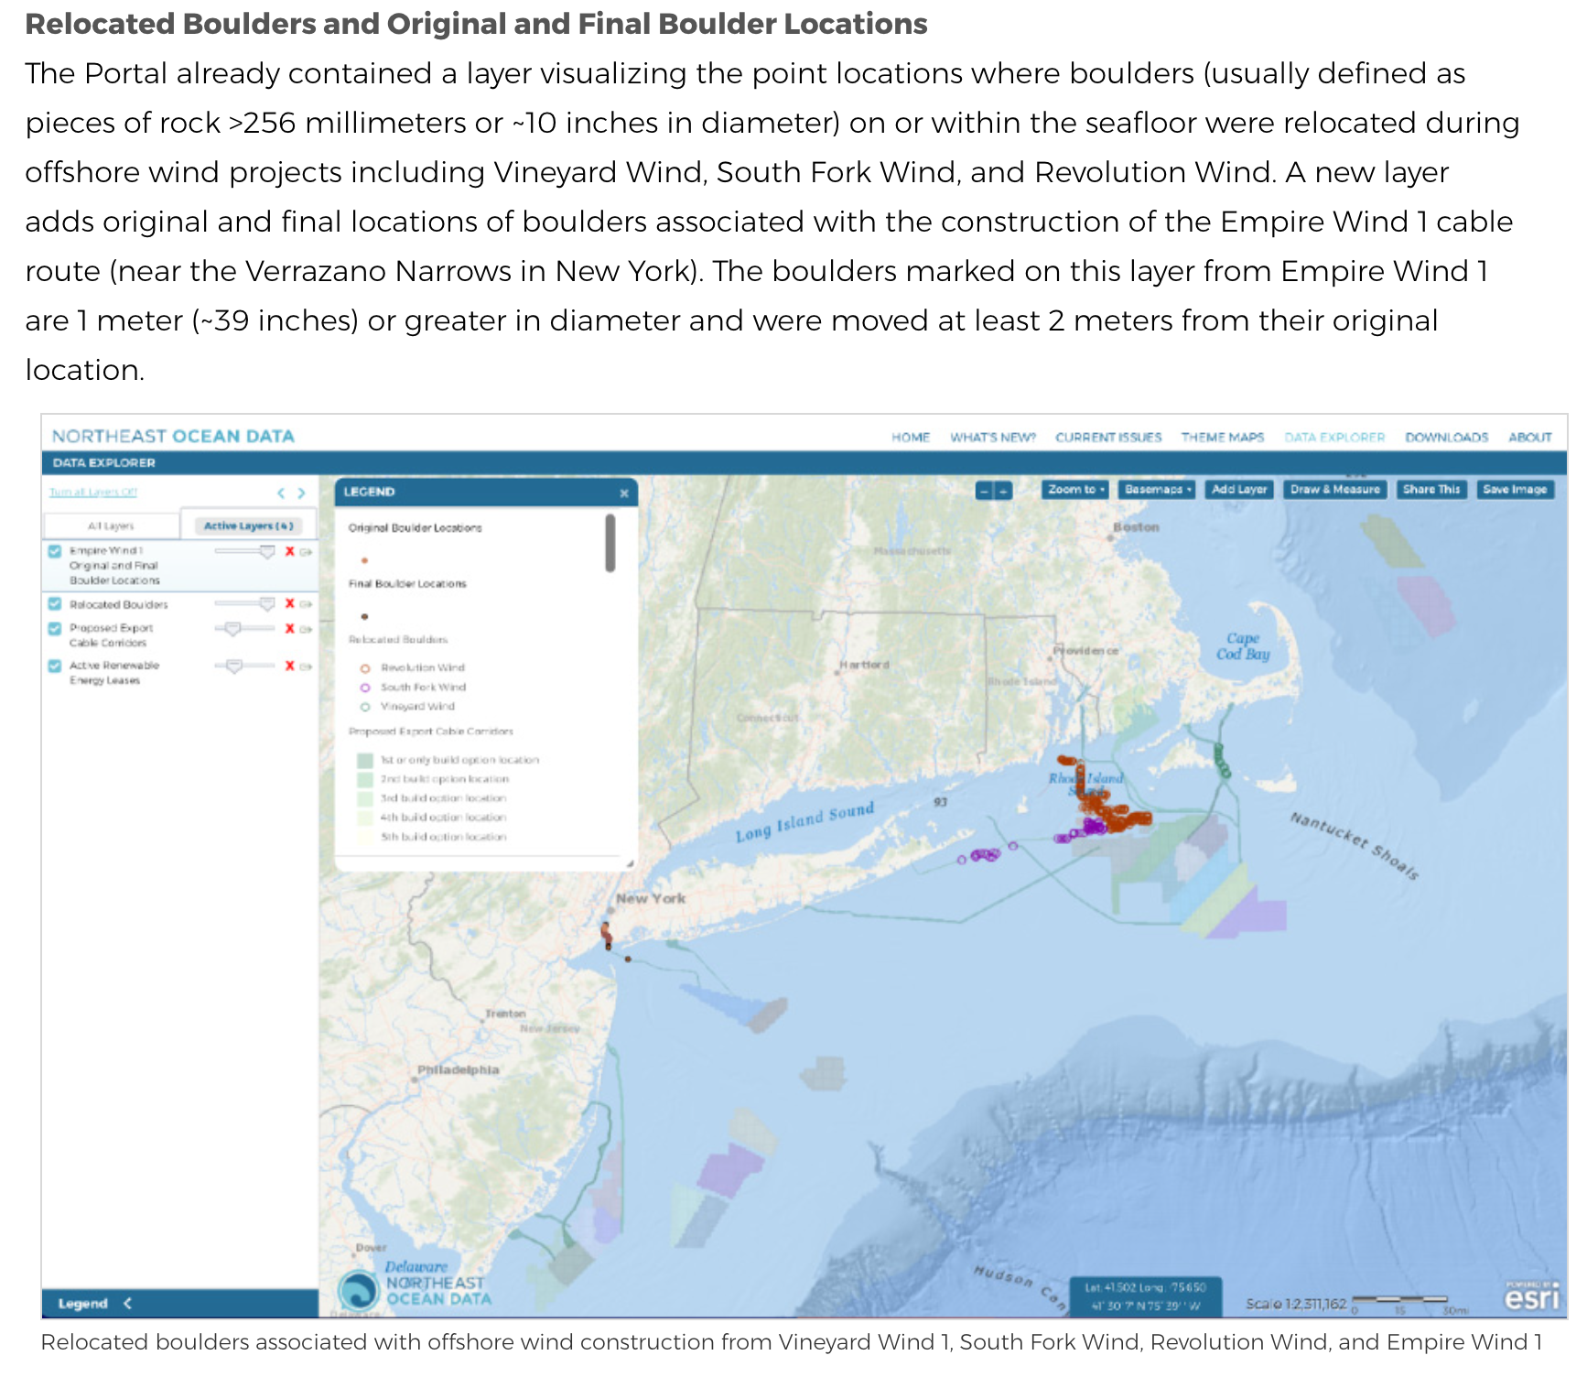
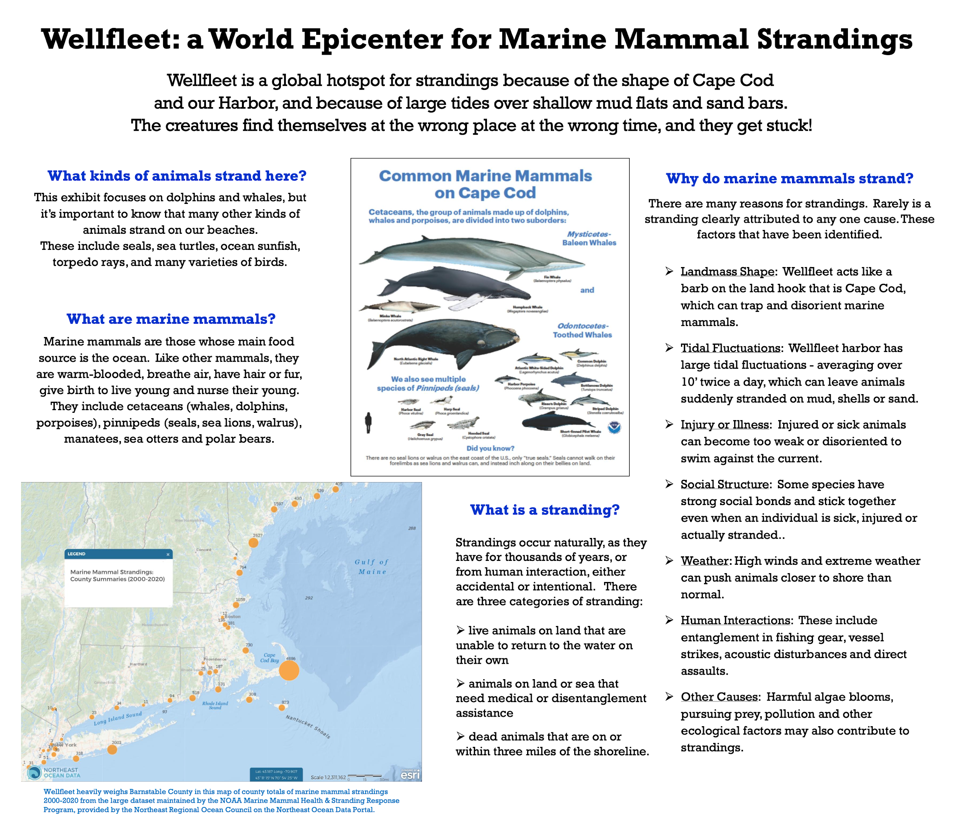
Why now?
There continues to be a diversity of uses of the Portal and Portal data
How else could we be using the Portal to support decision making?

Slide 4
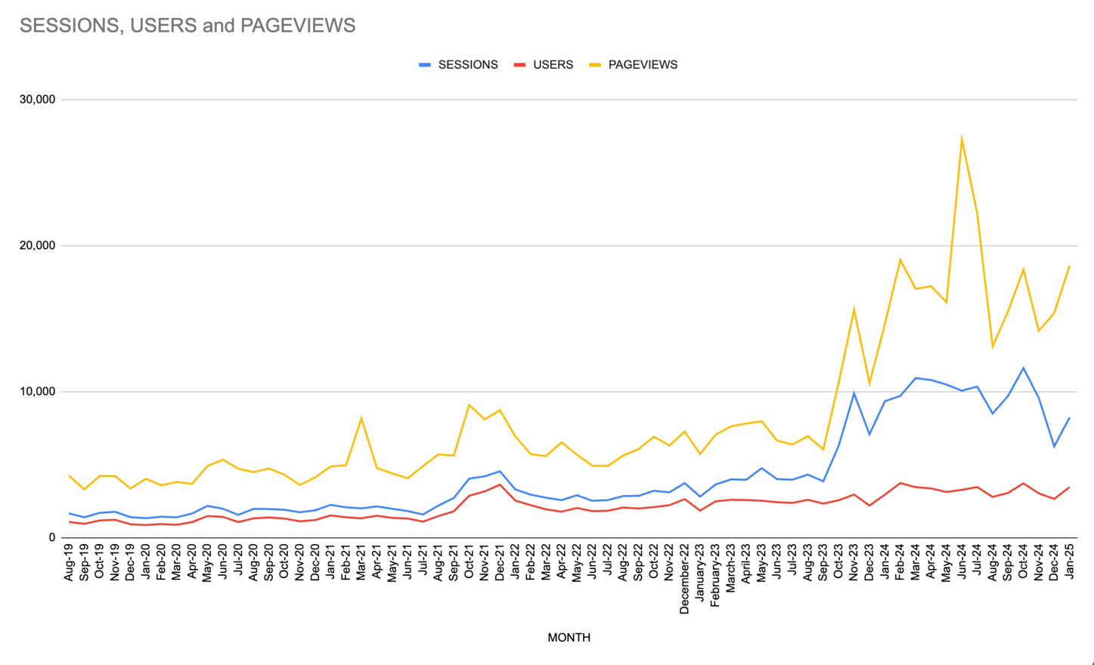
Why now?
Many years, significant increases in Portal use, and many new website and mapping requirements since the last complete overhaul and redesign in 2017
Upgrade user mapping and visualization tools and enhance connections to core external data providers
Improve integration of Portal webpages and contextual information with map interfaces and data products
2024
2019

Slide 5
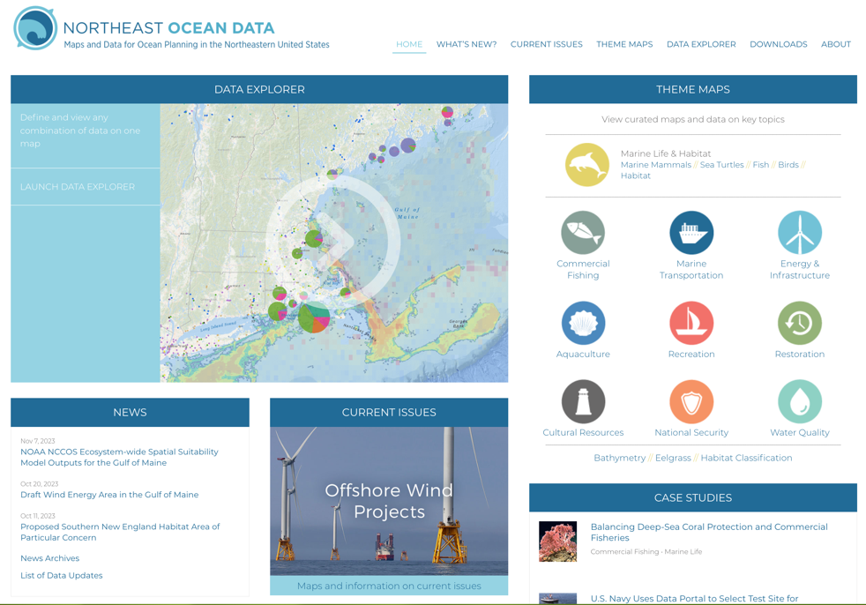
Why now?
Timeline
Started scoping in 2023
First public webinar to describe scope and timeline in January 2024
Implement first big updates in 2025
Continue to scope and implement additional tools and functions over time

Slide 6
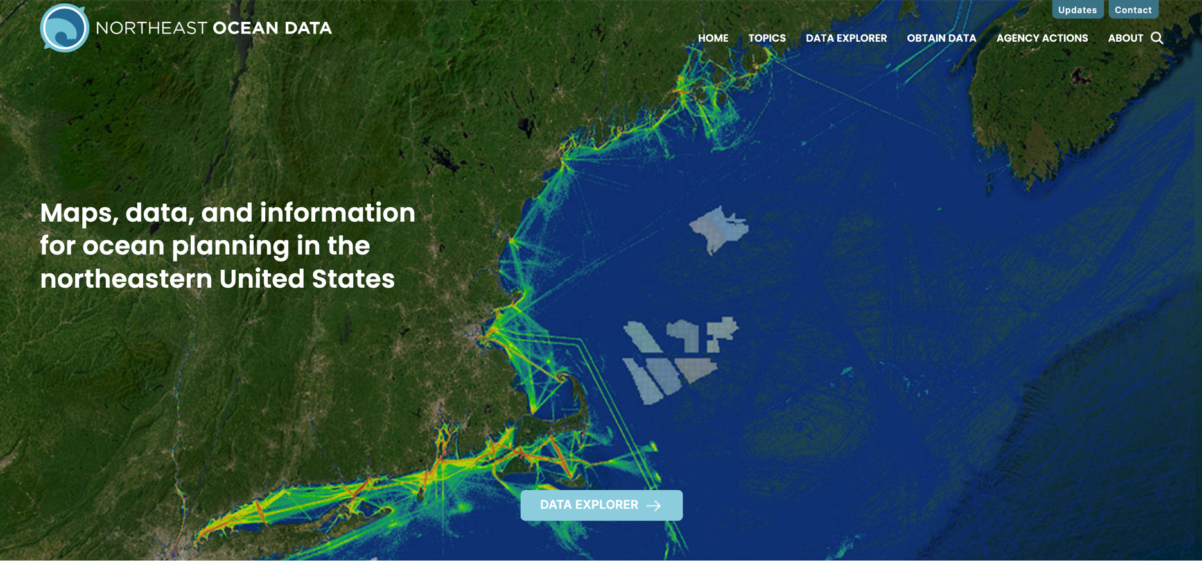
Major redesign project accomplishments since 2024
Fully redesigned and simplified webpage and Data Explorer tool

Slide 7
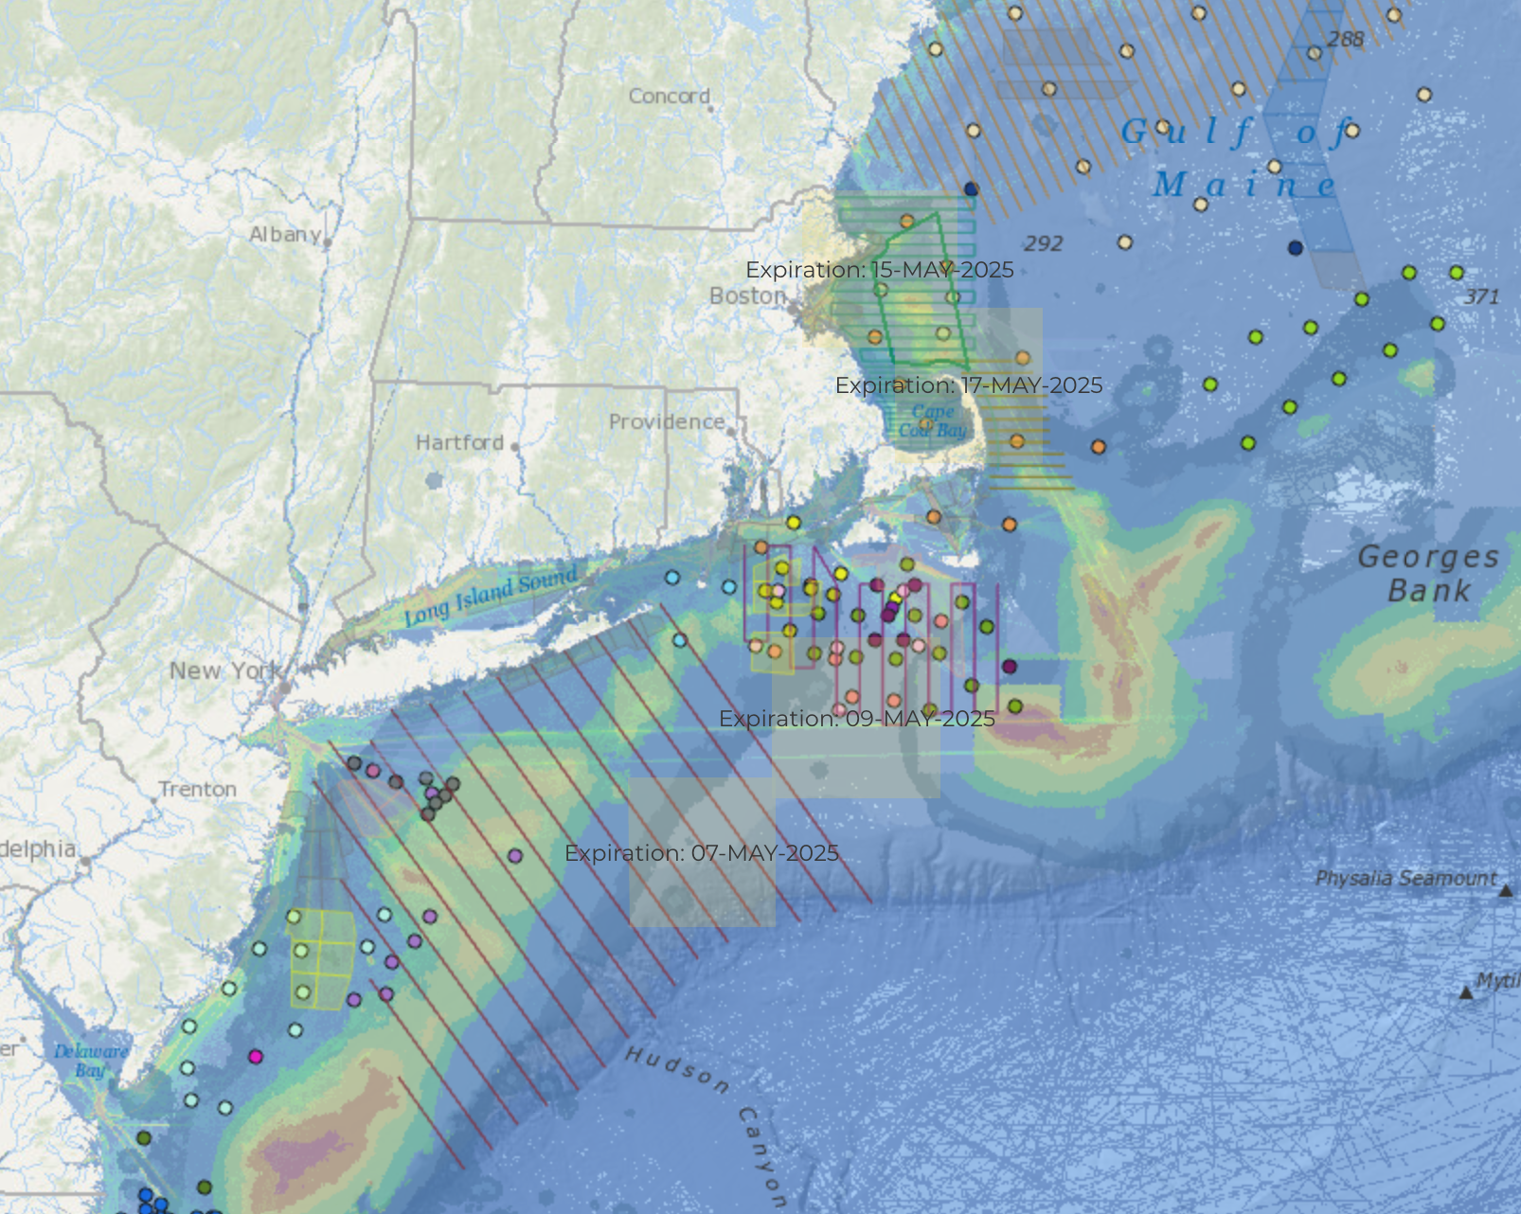
Reliable Maps, Data Products, and Ocean Data Systems for Business, Government and Research Decisions
Emily Shumchenia
NROC Science & Portal Director
RWSC Director

Slide 8
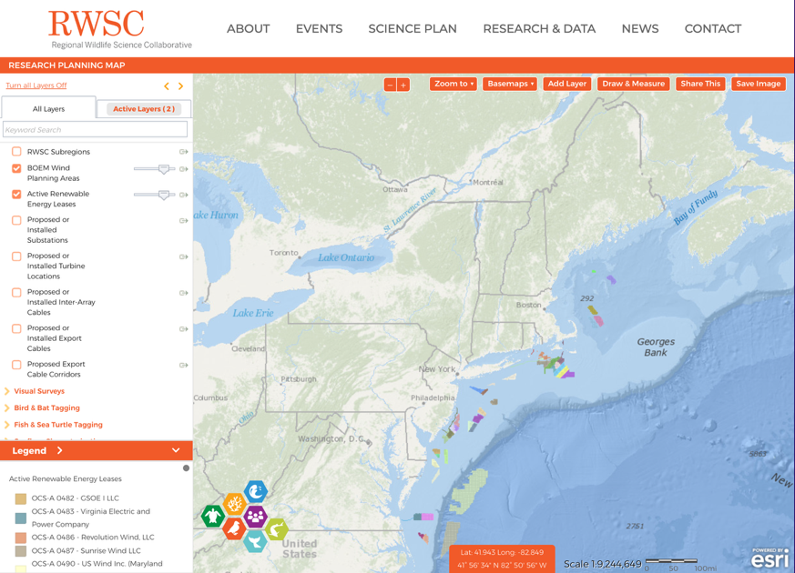
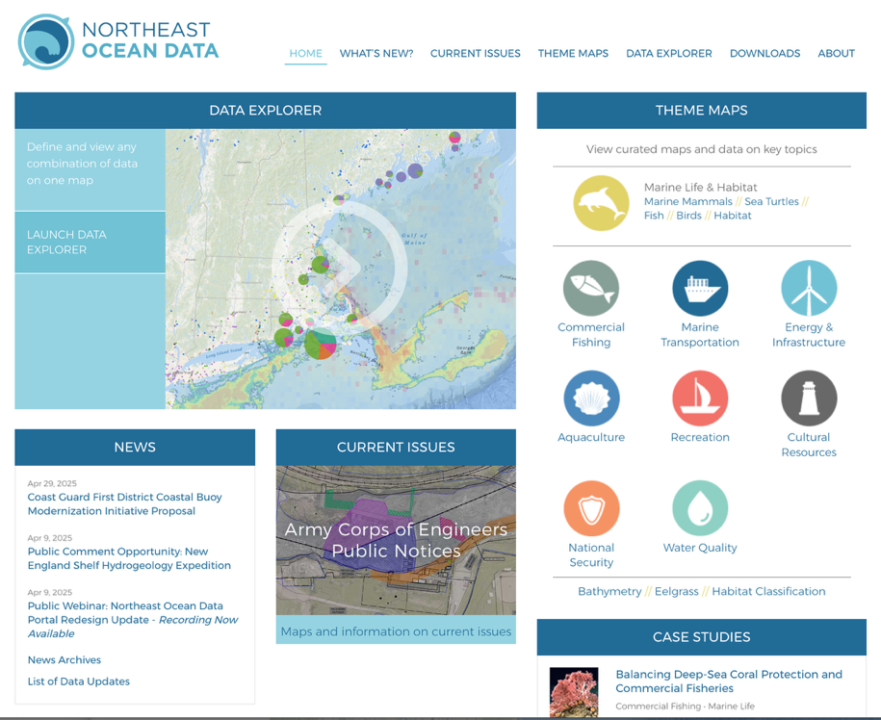
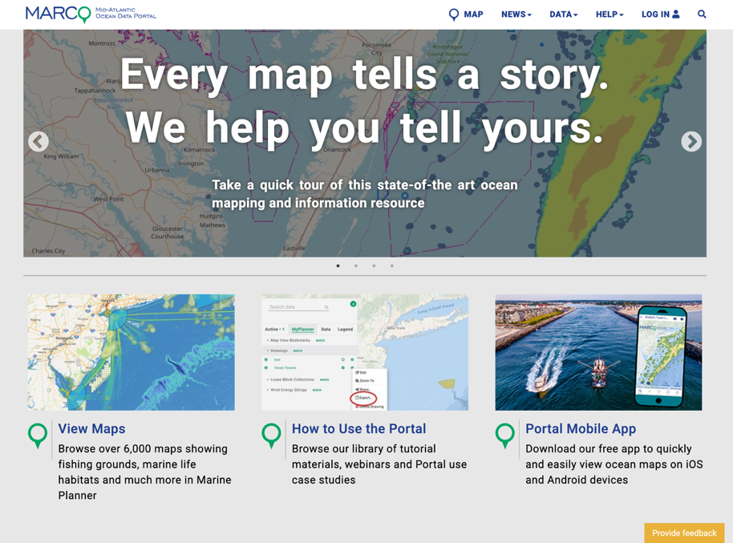
NROC & MARCO
Have been working with federal agencies, states, Tribes, industry, and researchers to develop industry- and peer-reviewed data products from existing data streams to be provided via the Northeast and Mid-Atlantic Ocean Data Portals
Specific recent effort to characterize the data landscape with respect to offshore fisheries, wildlife, and environmental data (RWSC and ROSA)

Slide 9
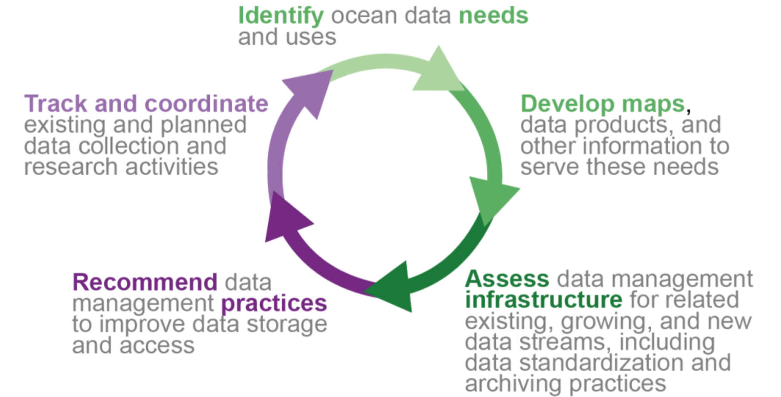
NROC MARCO RWSC ROSA working groups and subcommittees
Identify needs
Develop maps
Assess infrastructure
Recommend practices
Track & coordinate

Slide 10
NROC MARCO RWSC ROSA working groups and subcommittees
Identify needs
NROC & MARCO Committees and Working Groups
Develop maps
Track & coordinate
NROC & MARCO Working Groups
NROC & MARCO Working Groups, RWSC & ROSA
Assess infrastructure
Recommend practices
RWSC & ROSA
RWSC & ROSA

Slide 11
Many funders and collectors of ocean data
We have built an understanding of:
Research and data collection activities
Analysis, data product development
Data management, storage, and accessibility
Lack of standards, requirements, infrastructure = difficulty developing and maintaining data products

Slide 12
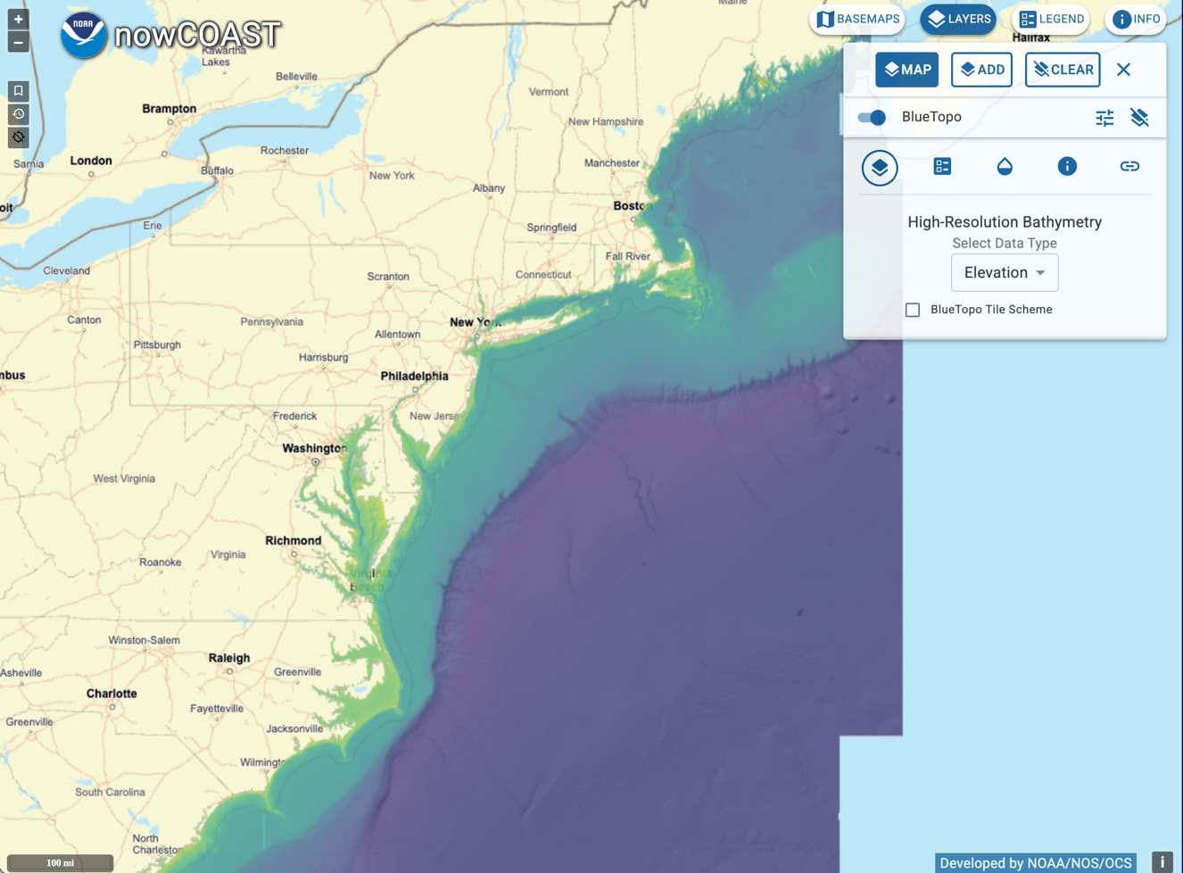
Examples of what’s worked well
AIS data products
BlueTopo
USCG NavCen Marine Safety Information Products - Local Notices to Mariners
Maybe POWERON is on its way there?
Agency/entity coordinates and standardizes data collection, QA/QC 🡪 collaboratively developed analyses 🡪 collaboratively developed data products that address multiple needs (ocean planning, regulatory, management) 🡪 repeatable, easy to update

Slide 13
Examples of challenges
The next several slides provide specific examples of challenges and how those challenges are currently inhibiting use of ocean data and decision-making
Example have been collected over time (some very recently) by speaking directly with staff within private and public entities who are responsible for data management, storage, and use for a range of types and applications (e.g., business decisions, resource management, permitting, research)

Slide 14
Seafloor data (from geophysical surveys, imagery, samples)
Examples of challenges
Many uses (habitat management, seafloor planning, industry, cultural/archaeological, research)
Long time lag between collection and made accessible
Many overlapping databases/repositories (NCEI, USGS, MGDS, industry, Regional Seafloor Data Repository)
Not all existing data are archived in a publicly-accessible archive (e.g., on hard drives in people’s offices)
Data have different levels of accessibility (industry, academia, govt)
Data are expensive to collect
Effects on use and decision-making
Agencies, Tribes, and businesses don’t have access to the best available information in a timely fashion
Seafloor data products are being developed with incomplete information (from data not available to anyone else or from just one or two repositories)
Other models that rely on seafloor data (oceanographic, species distribution models, habitat suitability models) output substandard results due to use of coarse and low-quality data

Slide 15
Seafloor data workflow example
Group | Role(s)
NROC & MARCO Ocean Planning Committees – Seafloor Planning Subcommittees
NROC Habitat Classification & Ocean Mapping Subcommittee | MARCO Seafloor Habitat Committee | NROC Submerged Cultural Resources Working Group
RWSC Habitat & Ecosystem Subcommittee, ROSA Data Governance Committee
Identify needs
Identify needs
Develop maps
Track & coordinate
Assess infrastructure
Recommend practices
Track & coordinate

Slide 16
NROC MARCO RWSC ROSA working groups and subcommittees
Identify needs
Develop maps
Assess infrastructure
Recommend practices
Track & coordinate

Slide 17
Supporting coordinated research
https://rwsc.org/research-data
RWSC Intellectual Property, Data Sharing, and Publications Policy
Suggested standard language for research agreements and contracts to ensure interoperable data
Data management and governance glossary
Essential metadata guidelines for marine life and habitat data
Updates to recommended repositories for publication and long-term storage of marine life and habitat data
A template for Data Management & Sharing Plans on DMPTool.org, customized for the RWSC community (login required)

Slide 18
Contact
Emily Shumchenia, RWSC Director
emily.shumchenia@rwsc.org
Reneé Reilly, ROSA Executive Director
renee@rosascience.org
Nick Napoli, NROC Executive Director
nnapoli@northeastoceancouncil.org
Avalon Bristow, MARCO Executive Director
abristow@midatlanticocean.org

